Slide 1
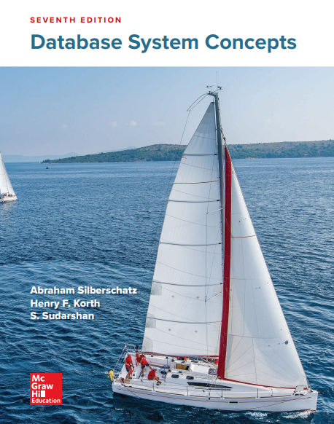
Advance Database -Lecture 3
By Dr. Taghinezhad
Mail:
a0taghinezhad@gmail.com
Website:
ataghinezhad.github.io
Notes:
Hello everyone,
I'm Dr. Taghinezhad, and I'm thrilled to be your guide through the exciting world of advanced databases this semester.
With a background in Computer Engineering and a focus on distributed systems, I've spent years diving into the intricacies of how data powers our digital world.
Throughout this course, we'll explore everything from the basics of data modeling to the complex database and distributed databases.
I believe in creating an environment where questions are encouraged, discussions are lively, and learning is a collaborative effort. So, I invite each of you to actively engage and share.
I want to introduce you to one of the major resources for this course: "Database System Concepts" by Abraham Silberschatz, Henry F. Korth, and S. Sudarshan.
This textbook is like our trusty map as we navigate the complex terrain of database systems. It's not just any map, though—it's a detailed, comprehensive guide that will help us understand the landscape, identify key landmarks, and chart our course to mastery.
If you are not going to attend in this calls. Please talk to before hand. Also select a representative among yourself.

Slide 2
Chapter 18 : Concurrency Control

Slide 3
Outline
Lock-Based Protocols
Timestamp-Based Protocols
Validation-Based Protocols
Multiple Granularity
Multiversion Schemes
Insert and Delete Operations
Concurrency in Index Structures

Slide 4
Lock-Based Protocols
A lock is a mechanism to control concurrent access to a data item
Data items can be locked in two modes :
1. exclusive (X) mode. Data item can be both read as well as written. X-lock is requested using lock-X instruction.
2. shared (S) mode. Data item can only be read. S-lock is
requested using lock-S instruction.
Lock requests are made to concurrency-control manager. Transaction can proceed only after request is granted.

Slide 5
Lock-Based Protocols (Cont.)
Lock-compatibility matrix
A transaction may be granted a lock on an item if the requested lock is compatible with locks already held on the item by other transactions
Any number of transactions can hold shared locks on an item,
But if any transaction holds an exclusive on the item no other transaction may hold any lock on the item.
Notes:
If a lock cannot be granted, the requesting transaction is made to wait till all incompatible locks held by other transactions have been released. The lock is then granted.
To state this more generally, given a set of lock modes, we can define a compatibility function on them as follows: Let A and B represent arbitrary lock modes. Suppose that a transaction Ti requests a lock of mode A on item Q on which transaction Tj (Ti ≠ Tj ) currently holds a lock of mode B. If transaction Ti can be granted a lock on Q immediately, in spite of the presence of the mode B lock, then we say mode A is compatible with mode B. Such a function can be represented conveniently by a matrix

Slide 6
Lock-Based Protocols (Cont.)
Example of a transaction performing locking:
T₂: lock-S(A);
read (A);
unlock(A);
lock-S(B);
read (B);
unlock(B);
display(A+B)
Locking as above is not sufficient to guarantee serializability

Slide 7
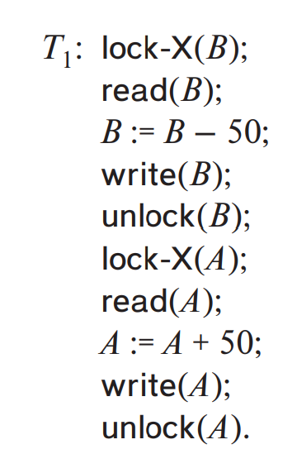
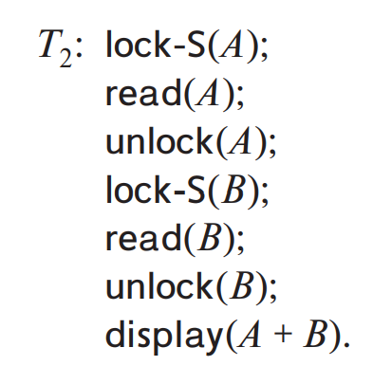
Suppose that the values of accounts A and B are $100 and $200,. If these two transactions are executed serially, order T1, T2 or the order T2, T1,
Then transaction T2 will display the value $300.
Notes:
If we do not use locking, or if we unlock data items too soon after reading or writing them, we may get inconsistent states
On the other hand, if we do not unlock a data item before requesting a lock on another data item, deadlocks may occur.

Slide 8
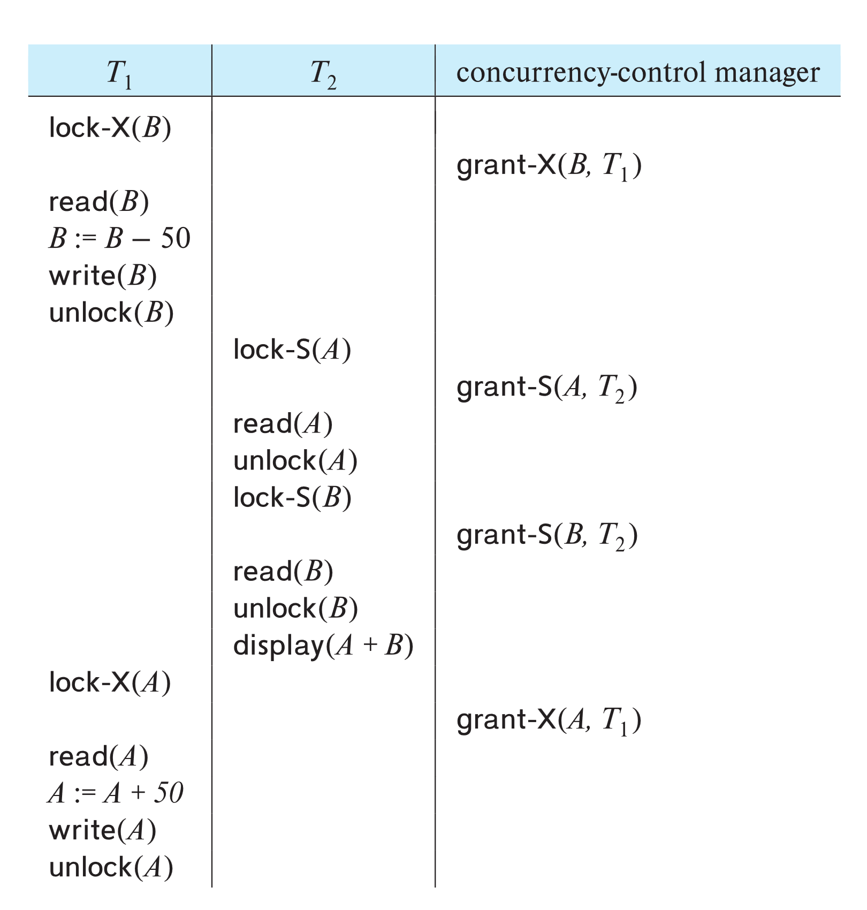
Schedule With Lock Grants
Grants omitted in rest of chapter
Assume grant happens just before the next instruction following lock request
This schedule is not serializable (why?)
A locking protocol is a set of rules followed by all transactions while requesting and releasing locks.
Locking protocols enforce serializability by restricting the set of possible schedules.
Notes:
If the previous example execute concurrently:
Suppose that the values of accounts A and B are $100 and $200, respectively. If these two transactions are executed serially, either in the order T1, T2 or the order T2, T1, then transaction T2 will display the value $300. If, however, these transactions are executed concurrently, then schedule 1, in Figure 18.4, is possible. In this case, transaction T2 displays $250, which is incorrect. The reason for this mistake is that the transaction T1 unlocked data item B too early, as a result of which T2 saw an inconsistent state.

Slide 9
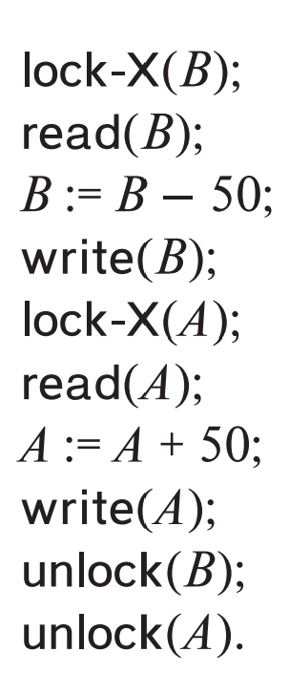
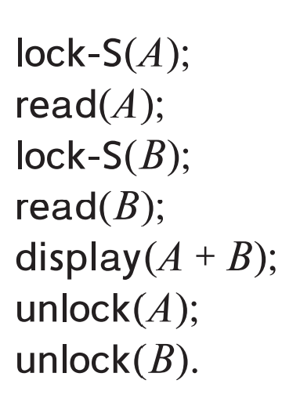
Schedule With Lock Grants
Same schedule but delayed unlocks:
Notes:
Suppose now that unlocking is delayed to the end of the transaction. Transaction T3 corresponds to T1 with unlocking delayed (Figure 18.5). Transaction T4 corresponds to T2 with unlocking delayed (Figure 18.6). You should verify that the sequence of reads and writes in schedule 1, which lead to an incorrect total of $250 being displayed, is no longer possible with T3 and T4. Other schedules are possible. T4 will not print out an inconsistent result in any of them; we shall see why later

Slide 10
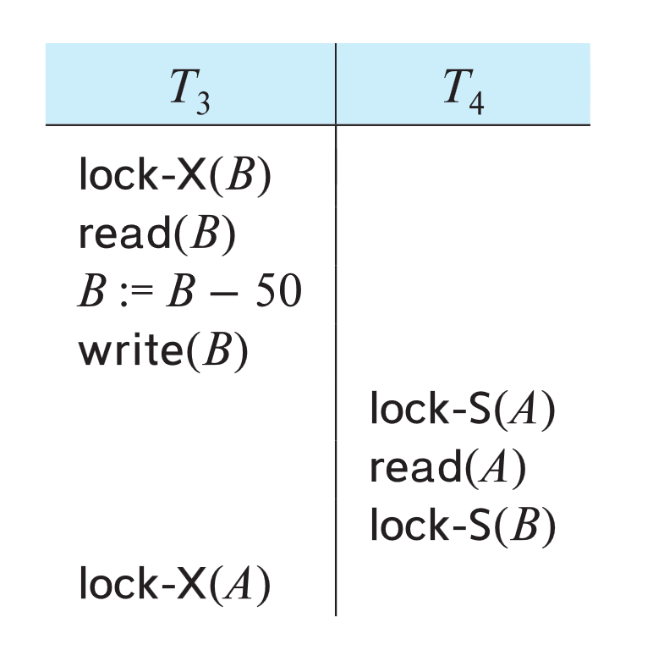
Deadlock
Consider the partial schedule
Neither T₃ nor T₄ can make progress — executing lock-S(B) causes T₄ to wait for T₃ to release its lock on B, while executing lock-X(A) causes T₃ to wait for T₄ to release its lock on A.
Such a situation is called a deadlock.
To handle a deadlock one of T₃ or T₄ must be rolled back and its locks released.
Notes:
When deadlock occurs, the system must roll back one of the two transactions. Once a transaction has been rolled back, the data items that were locked by that transaction are unlocked. These data items are then available to the other transaction, which can continue with its executio

Slide 11
Deadlock (Cont.)
The potential for deadlock exists in most locking protocols. Deadlocks are a necessary evil.
Starvation is also possible if concurrency control manager is badly designed. For example:
A transaction may be waiting for an X-lock on an item, while a sequence of other transactions request and are granted an S-lock on the same item.
The same transaction is repeatedly rolled back due to deadlocks.
Concurrency control manager can be designed to prevent starvation.

Slide 12
The Two-Phase Locking Protocol
A protocol which ensures conflict-serializable schedules.
Phase 1: Growing Phase
Transaction may obtain locks
Transaction may not release locks
Phase 2: Shrinking Phase
Transaction may release locks
Transaction may not obtain locks
The protocol assures serializability. It can be proved that the transactions can be serialized in the order of their lock points (i.e., the point where a transaction acquired its final lock).
Locks
Time

Slide 13
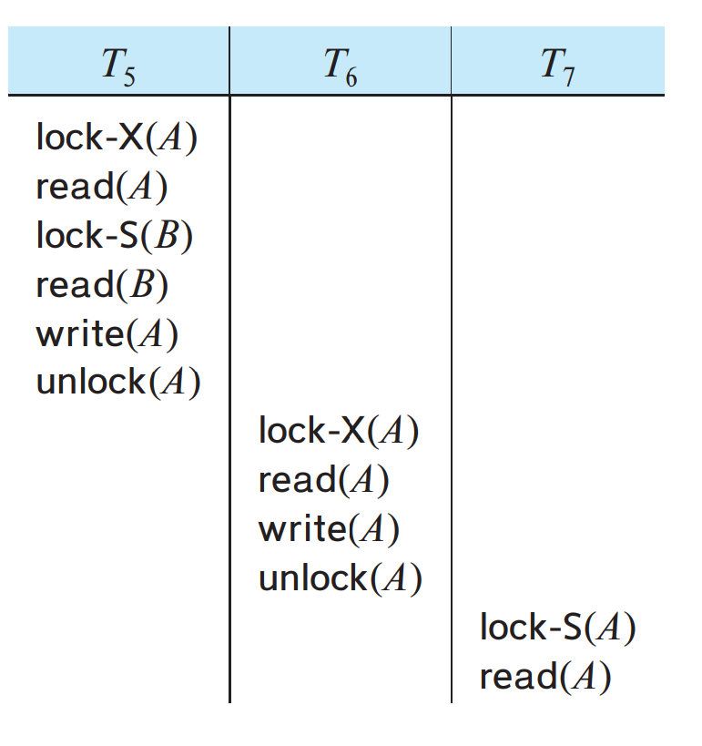
Cascading rollback may occur under two-phase locking.
Each transaction observes the two-phase locking protocol, but the failure of T5 after the read(A) step of T7 leads to cascading rollback of T6 and T7
Notes:
Each transaction observes the two-phase locking protocol, but the failure of T5 after the read(A) step of T7 leads to cascading rollback of T6 and T7
Cascading rollbacks can be avoided by a modification of two-phase locking called the strict two-phase locking protocol. This protocol requires not only that locking be two phase, but also that all exclusive-mode locks taken by a transaction be held until that transaction commits. This requirement ensures that any data written by an uncommitted transaction are locked in exclusive mode until the transaction commits, preventing any other transaction from reading the data.

Slide 14
The Two-Phase Locking Protocol (Cont.)
Two-phase locking does not ensure freedom from deadlocks
Extensions to basic two-phase locking needed to ensure recoverability of freedom from cascading roll-back
Strict two-phase locking: a transaction must hold all its exclusive locks till it commits/aborts.
Ensures recoverability and avoids cascading roll-backs
Rigorous two-phase locking: a transaction must hold all locks till commit/abort.
Transactions can be serialized in the order in which they commit.
Most databases implement rigorous two-phase locking, but refer to it as simply two-phase locking
Notes:
قفل دو مرحله ای (Two-phase locking) تضمینی برای جلوگیری از بن‌ بست (deadlock) نیست.
برای اطمینان از بازیابی (recoverability) و جلوگیری از بازگشت آبشاری (cascading rollback) به گسترش‌هایی بر قفل دو مرحله‌ای پایه‌ای نیاز است:
قفل دو مرحله‌ای سختگیرانه (Strict two-phase locking): یک تراکنش باید تمام قفل‌های انحصاری خود را تا زمان انجام (commit) یا لغو (abort) شدن، نگه دارد.
بازیابی را تضمین می‌کند و از بازگشت آبشاری جلوگیری می‌کند.
قفل دو مرحله‌ای دقیق یا شدید(Rigorous two-phase locking): یک تراکنش باید تمام قفل‌ها را تا زمان انجام یا لغو شدن، نگه دارد.
تراکنش‌ها را می‌توان به ترتیبی که انجام می‌شوند، سریال‌سازی کرد (serialized).
اکثر پایگاه‌های داده از قفل دو مرحله‌ای دقیق استفاده می‌کنند، اما به سادگی آن را قفل دو مرحله‌ای می‌نامند.

Slide 15
The Two-Phase Locking Protocol (Cont.)
Two-phase locking is not a necessary condition for serializability
There are conflict serializable schedules that cannot be obtained if the two-phase locking protocol is used.
In the absence of extra information (e.g., ordering of access to data), two-phase locking is necessary for conflict serializability in the following sense:
Given a transaction T_{i} that does not follow two-phase locking, we can find a transaction T_{j} that uses two-phase locking, and a schedule for T_{i} and T_{j} that is not conflict serializable.
Notes:
Two-phase locking does not ensure freedom from deadlock. Observe that transactions T3 and T4 are two phase, but, in schedule 2 (Figure 18.7), they are deadloc

Slide 16
Locking Protocols
Given a locking protocol (such as 2PL)
A schedule S is legal under a locking protocol if it can be generated by a set of transactions that follow the protocol
A protocol ensures serializability if all legal schedules under that protocol are serializable
Notes:
با فرض یک پروتکل قفل (مانند 2PL)
یک جدولی (schedule) S تحت یک پروتکل قفل معتبر است، اگر بتوان آن را توسط مجموعه‌ای از تراکنش‌هایی که پروتکل را دنبال می‌کنند، تولید کرد.
یک پروتکل قابلیت سریال‌سازی را تضمین می‌کند، اگر همه جداول (schedules) معتبر تحت آن پروتکل، قابل سریال‌سازی باشند.

Slide 17
Lock Conversions
Two-phase locking protocol with lock conversions:
– Growing Phase:
can acquire a lock-S on item
can acquire a lock-X on item
can convert a lock-S to a lock-X (upgrade)
– Shrinking Phase:
can release a lock-S
can release a lock-X
can convert a lock-X to a lock-S (downgrade)
This protocol ensures serializability
Notes:
تبدیل قفل

Slide 18
Automatic Acquisition of Locks
A transaction T_{i} issues the standard read/write instruction, without explicit locking calls.
The operation read(D) is processed as:
if T_{i} has a lock on D
then
read(D)
else begin
if necessary wait until no other
transaction has a lock-X on D
grant T_{i} a lock-S on D;
read(D)
end

Slide 19
Automatic Acquisition of Locks (Cont.)
The operation write(D) is processed as:
if T_{i} has a lock-X on D
then
write(D)
else begin
if necessary wait until no other trans. has any lock on D,
if T_{i} has a lock-S on D
then
upgrade lock on D to lock-X
else
grant T_{i} a lock-X on D
write(D)
end;
All locks are released after commit or abort

Slide 20
Implementation of Locking
A lock manager can be implemented as a separate process
Transactions can send lock and unlock requests as messages
The lock manager replies to a lock request by sending a lock grant messages (or a message asking the transaction to roll back, in case of a deadlock)
The requesting transaction waits until its request is answered
The lock manager maintains an in-memory data-structure called a lock table to record granted locks and pending requests
Notes:
The lock manager for each data item that is currently locked, maintains a linked list of records, one for each request, in the order in which the requests arrived. It uses a hash table, indexed on the name of a data item, to find the linked list (if any) for a data item; this table is called the lock table.
Each record of the linked list for a data item notes which transaction made the request, and what lock mode it requested.
برای هر آیتم داده‌ای که در حال حاضر قفل شده است، مدیر قفل یک لیست پیوندی از رکوردها را نگهداری می‌کند که برای هر درخواست، به ترتیبی که درخواست‌ها رسیده‌اند، یک رکورد وجود دارد. برای یافتن لیست پیوندی (در صورت وجود) برای یک آیتم داده، از یک جدول hash استفاده می‌کند که با نام آیتم داده فهرست می‌شود. این جدول، جدول قفل نامیده می‌شود.
هر رکورد از لیست پیوندی برای یک آیتم داده، مشخص می‌کند که کدام تراکنش درخواست را ارسال کرده است و چه حالت قفلی را درخواست کرده است.

Slide 21
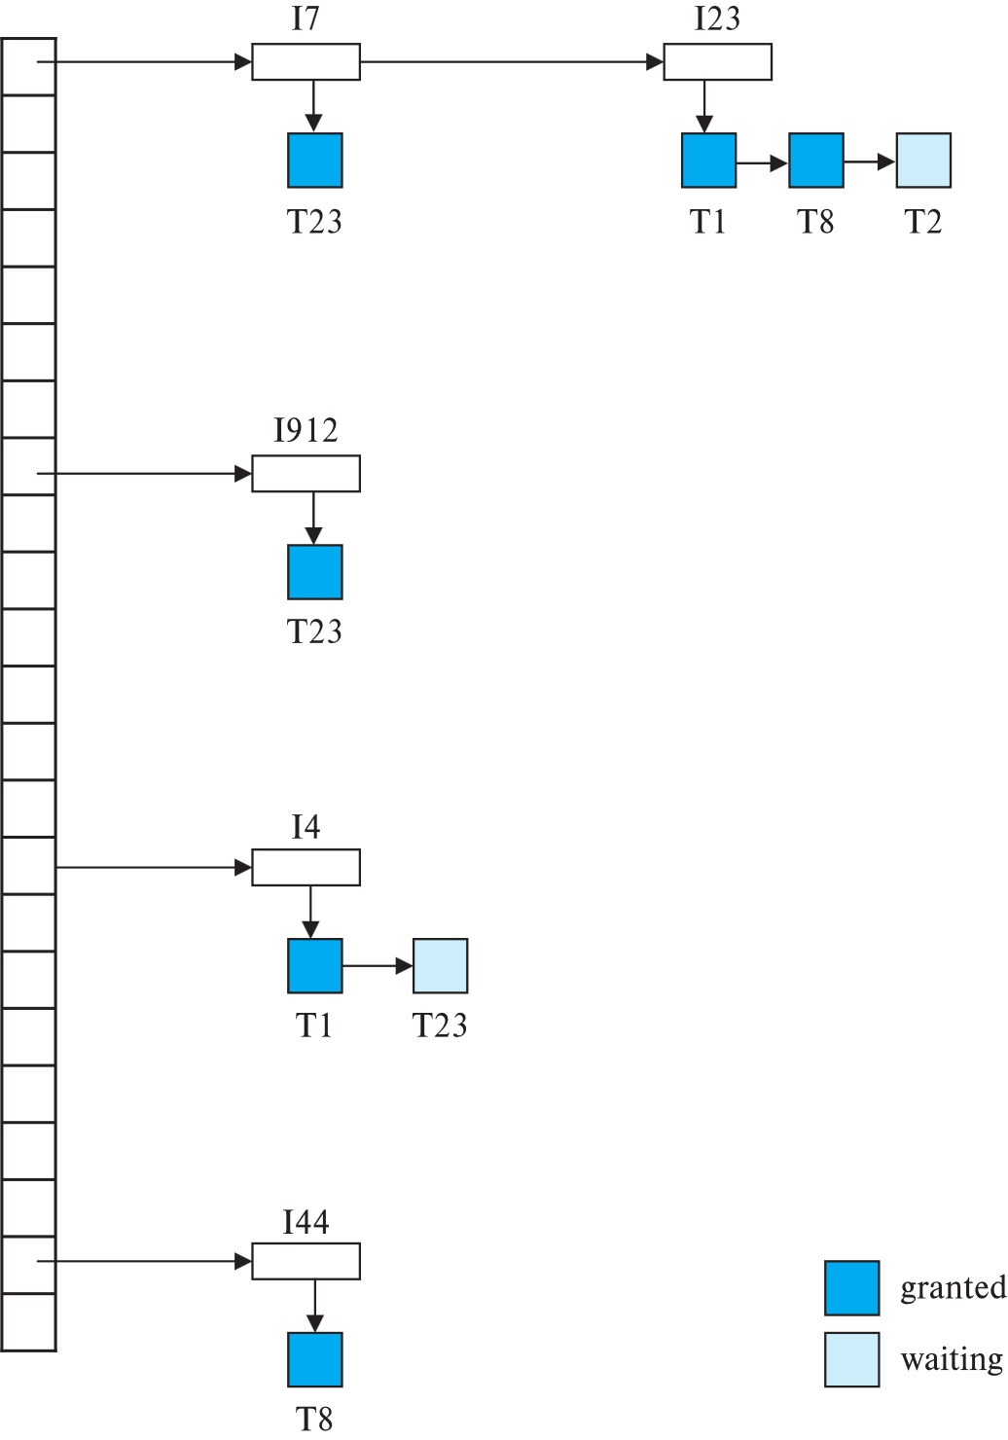
Lock Table
Dark rectangles indicate granted locks, light colored ones indicate waiting requests
Lock table also records the type of lock granted or requested
New request is added to the end of the queue of requests for the data item, and granted if it is compatible with all earlier locks
Unlock requests result in the request being deleted, and later requests are checked to see if they can now be granted
If transaction aborts, all waiting or granted requests of the transaction are deleted
lock manager may keep a list of locks held by each transaction, to implement this efficiently
Notes:
جدول قفل حاوی قفل‌هایی برای پنج آیتم داده‌ مختلف است: I4، I7، I23، I44 و I912.
جدول قفل از زنجیره‌سازی سرریز (overflow chaining) استفاده می‌کند، بنابراین برای هر ورودی در جدول قفل، یک لیست پیوندی از آیتم‌های داده وجود دارد. همچنین برای هر یک از آیتم‌های داده، فهرستی از تراکنش‌هایی که قفل دریافت کرده‌اند یا منتظر قفل هستند، وجود دارد.
برای ساده‌تر شدن شکل، حالت قفل را حذف کرده‌ایم. برای مثال، می‌توان دید که به T23 قفل‌هایی روی I912 و I7 اعطا شده است و در حال انتظار برای یک قفل روی I4 است.
هنگامی که پیام درخواست قفل می‌رسد، اگر لیست پیوندی برای آیتم داده وجود داشته باشد، رکوردی به انتهای آن اضافه می‌کند. در غیر این صورت، یک لیست پیوندی جدید ایجاد می‌کند که فقط شامل رکورد درخواست است.
The table contains locks for five different data items, I4, I7, I23, I44, and I912.
The lock table uses overflow chaining, so there is a linked list of data items for each entry in the lock table. There is also a list of transactions that have been granted locks, or are waiting for locks, for each of the data items.
We have omitted the lock mode to keep the figure simple. It can be seen, for example, that T23 has been granted locks on I912 and I7 and is waiting for a lock on I4.
When a lock request message arrives, it adds a record to the end of the linked list for the data item, if the linked list is present. Otherwise it creates a new linked list, containing only the record for the request.

Slide 22
Graph-Based Protocols
Graph-based protocols are an alternative to two-phase locking
Impose a partial ordering → on the set D = {d₁, d₂ ,..., d_{h}} of all data items.
If d_{i} → d_{j} then any transaction accessing both d_{i} and d_{j} must access d_{i} before accessing d_{j}.
Implies that the set D may now be viewed as a directed acyclic graph, called a database graph.
The tree-protocol is a simple kind of graph protocol.
Notes:
we need additional information on how each transaction will access the database. There are various models that can give us the additional information, each differing in the amount of information provided. The simplest model requires that we have prior knowledge about the order in which the database items will be accessed.
Given such information, it is possible to construct locking protocols that are not two phase, but that, nevertheless, ensure conflict serializability.

Slide 23
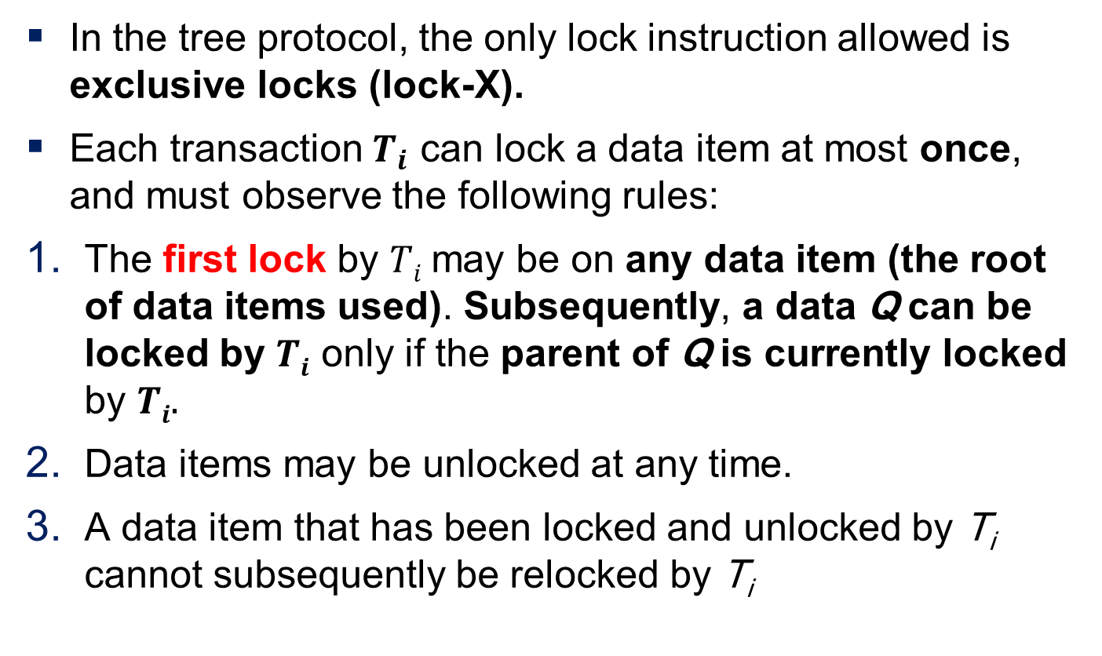
Tree Protocol
In the tree protocol, the only lock instruction allowed is exclusive locks (lock-X).
Each transaction $T_{i}$ can lock a data item at most once, and must observe the following rules:
The first lock by $Ti$may be on any data item (the root of data items used). Subsequently, a data Q can be locked by $Ti$ only if the parent of Q is currently locked by $Ti.$
Data items may be unlocked at any time.
A data item that has been locked and unlocked by T_{i} cannot subsequently be relocked by T_{i}
Notes:
درخت پروتکل (Tree Protocol) یک روش سازمان‌دهی داده‌ها به شکل درختی است که در علم کامپیوتر و شبکه‌ها کاربرد دارد. اما اگر بخواهیم آن را به‌صورت انسانی‌تر توصیف کنیم، می‌توان آن را به یک اجتماع یا خانواده بزرگ تشبیه کرد.
تصور کنید که یک خانواده دارید که در رأس آن یک بزرگ‌تر قرار دارد (ریشهٔ درخت). این فرد مسئول هماهنگی بین اعضای مختلف خانواده است. هر یک از اعضای خانواده فرزندانی دارند که خودشان شبکه‌ای از ارتباطات ایجاد می‌کنند. درست مانند درخت، هر شاخه به شاخه‌های کوچک‌تر تقسیم می‌شود و در نهایت به برگ‌ها می‌رسد، که می‌توان آن‌ها را به اطلاعات یا داده‌هایی تشبیه کرد که در این ساختار قرار دارند.
Is the Tree Locking Protocol Used in Practical and Real-Time Applications?
The Tree Locking Protocol is a theoretically elegant solution for hierarchical data structures, but its practical adoption in real-world systems is limited compared to other concurrency control mechanisms like B-tree locking (with intention locks), optimistic concurrency control (OCC), or multi-version concurrency control (MVCC).
However, some specialized systems do use variations of tree locking, particularly in:
1. Database Index Structures (B-trees, B+-trees)
Most modern databases (PostgreSQL, MySQL, Oracle) use B-tree/B+-tree indexes, but they do not strictly follow the classic Tree Protocol.
Instead, they use optimized locking schemes like:
B-link trees (for high concurrency with lock coupling).
Intention locks (IS, IX, S, X) for hierarchical locking.
Optimistic Concurrency Control (OCC) or Multi-Versioning (MVCC) to avoid locks altogether.

Slide 24
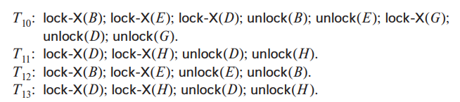
Tree Protocol
Notes:
The partial ordering implies that the set D may now be viewed as a directed acyclic graph, called a database graph.

Slide 25
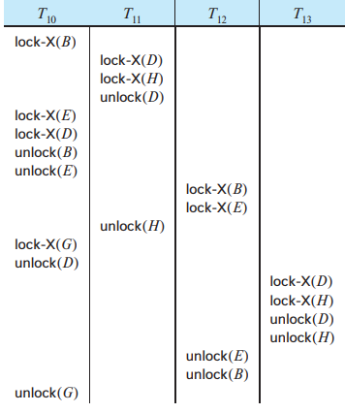
Tree Protocol
One possible schedule in which these four transactions participated appears in Figure
During its execution, transaction T10 holds locks on two disjoint subtrees. Observe that the schedule of Figure is conflict serializable.
It can be shown not only that the tree protocol ensures conflict serializability, but also that this protocol ensures freedom from deadlock
Notes:
The tree protocol in Figure 18.12 does not ensure recoverability and cascadelessness. To ensure recoverability and cascadelessness, the protocol can be modified to not permit release of exclusive locks until the end of the transaction. Holding exclusive locks until the end of the transaction reduces concurrency. Here is an alternative that improves concurrency, but ensures only recoverability.
For each data item with an uncommitted write, we record which transaction performed the last write to the data item. Whenever a transaction Ti performs a read of an uncommitted data item, we record a commit dependency of Ti on the transaction that performed the last write to the data item.
Transaction Ti is then not permitted to commit until the commit of all transactions on which it has a commit dependency. If any of these transactions aborts, Ti must also be aborted.

Slide 26
Graph-Based Protocols (Cont.)
The tree protocol ensures conflict serializability as well as freedom from deadlock.
Unlocking may occur earlier in the tree-locking protocol than in the two-phase locking protocol.
Shorter waiting times, and increase in concurrency
Protocol is deadlock-free, no rollbacks are required

Slide 27
Graph-Based Protocols (Cont.)
Drawbacks
Protocol does not guarantee recoverability or cascade freedom
Need to introduce commit dependencies to ensure recoverability
Transactions may have to lock data items that they do not access.
increased locking overhead, and additional waiting time
potential decrease in concurrency
Schedules not possible under two-phase locking are possible under the tree protocol, and vice versa.

Slide 28



Graph-Based Protocols (Cont.)
Drawback:
a transaction that needs to access data items A and J in the database graph of must lock not only A and J, but also data items B, D, H
Notes:
without prior knowledge of what data items will need to be locked, transactions will have to lock the root of the tree, and that can reduce concurrency greatly.
For a set of transactions, there may be conflict-serializable schedules that cannot be obtained through the tree protocol. Indeed, there are schedules possible under the two-phase locking protocol that are not possible under the tree protocol, a

Slide 29
Deadlock Handling
System is deadlocked if there is a set of transactions such that every transaction in the set is waiting for another transaction in the set.

Slide 30
Deadlock Handling
Deadlock prevention protocols ensure that the system will never enter into a deadlock state. Some prevention strategies:
Require that each transaction locks all its data items before it begins execution (pre-declaration).
Impose partial ordering of all data items and require that a transaction can lock data items only in the order specified by the partial order (graph-based protocol).
Notes:
ترتیب جزئی همه اقلام داده را تحمیل کنید و لازم است که یک تراکنش بتواند موارد داده را فقط به ترتیبی که توسط ترتیب جزئی مشخص شده است قفل کند (پروتکل مبتنی بر نمودار).

Slide 31
More Deadlock Prevention Strategies
wait-die scheme — non-preemptive
Older transaction may wait for younger one to release data item.
Younger transactions never wait for older ones; they are rolled back instead.
A transaction may die several times before acquiring a lock
Notes:
قطع وابستگی پیشگیرانه طرح «انتظار-مرگ»:
در این طرح، تراکنش قدیمی‌تر (با زمان‌بندی اولیه) مجاز است تا زمانی که تراکنش جوان‌تر (با زمان‌بندی بعدی) داده را آزاد کند، منتظر بماند.
تراکنش‌های جوان‌تر هرگز منتظر تراکنش‌های قدیمی‌تر نمی‌شوند. در صورت مواجهه با تراکنش قدیمی‌تر در حال نگهداری قفل، تراکنش‌های جوان‌تر لغو (Rollback) می‌شوند.
یک تراکنش ممکن است قبل از دستیابی به قفل مورد نظر، چندین بار لغو شود.

Slide 32
wait-die scheme, Example
suppose that transactions T14, T15, and T16 have timestamps 5, 10, and 15, respectively.
If T14 requests a data item held by T15, then what will happen?
If T16 requests a data item held by T15, then what will happen?
Notes:
Solution
If T14 requests a data item held by T15, then T14 will wait.
If T16 requests a data item held by T15, then T16 will be rolled back

Slide 33
More Deadlock Prevention Strategies
wound-wait scheme — preemptive
Older transaction wounds (forces rollback) of younger transaction instead of waiting for it.
Younger transactions may wait for older ones.
Fewer rollbacks than wait-die scheme.
In both schemes, a rolled back transactions is restarted with its original timestamp.
Ensures that older transactions have precedence over newer ones, and starvation is thus avoided.
Notes:
طرح «زخم-انتظار»: پیش‌گیرنده
در این طرح، تراکنش قدیمی‌تر (با زمان‌بندی اولیه) به جای اینکه منتظر تراکنش جوان‌تر (با زمان‌بندی بعدی) بماند، آن را زخمی می‌کند (مجبور به لغو شدن می‌کند).
تراکنش‌های جوان‌تر ممکن است برای تراکنش‌های قدیمی‌تر منتظر بمانند.
در مقایسه با طرح «انتظار-مرگ»، تعداد دفعات لغو تراکنش‌ها کمتر است.
در هر دو طرح، تراکنش‌های لغو شده با همان زمان‌بندی اولیه خود مجددا راه‌اندازی می‌شوند.
این طرح تضمین می‌کند که تراکنش‌های قدیمی‌تر نسبت به تراکنش‌های جدیدتر اولویت داشته باشند و در نتیجه از گرسنگی (عدم دسترسی به منابع) جلوگیری می‌شود.

Slide 34
Wound-die scheme, Example
suppose that transactions T14, T15, and T16 have timestamps 5, 10, and 15, respectively.
if T14 requests a data item held by T15, then what happens?
If T16 requests a data item held by T15, then what happens?
Notes:
Solution
if T14 requests a data item held by T15, then the data item will be preempted from T15, and T15 will be rolled back.
If T16 requests a data item held by T15, then T16 will wait.

Slide 35
Deadlock prevention (Cont.)
Timeout-Based Schemes:
A transaction waits for a lock only for a specified amount of time. After that, the wait times out and the transaction is rolled back.
Ensures that deadlocks get resolved by timeout if they occur
Simple to implement
But may roll back transaction unnecessarily in absence of deadlock
Difficult to determine good value of the timeout interval.
Starvation is also possible
Notes:
طرح‌های مبتنی بر زمان‌سنج:
تراکنش تنها برای مدت زمان مشخصی برای قفل صبر می‌کند. پس از آن، زمان انتظار تمام می‌شود و تراکنش لغو (Rollback) می‌شود.
در صورت وقوع بن‌بست، با زمان‌سنج حل می‌شود.
ساده برای اجرا
اما ممکن است در صورت عدم وجود بن‌بست، تراکنش را به‌طور غیرضروری لغو کند.
§ تعیین مقدار مناسب برای فاصله زمانی زمان‌سنج دشوار است.
گرسنگی (عدم دسترسی به منابع) نیز ممکن است رخ دهد.

Slide 36
Deadlock Detection
in the systems that do not prevent deadlock
Wait-for graph
Vertices: transactions
Edge from T_{i} →T_{j}. : if T_{i} is waiting for a lock held in conflicting mode by T_{j}
The system is in a deadlock state if and only if the wait-for graph has a cycle.
Invoke a deadlock-detection algorithm periodically to look for cycles.
Wait-for graph without a cycle
Wait-for graph with a cycle
Notes:
If deadlocks are not prevented, the system must deal with them by using a deadlock detection and recovery scheme. To do so, the system constructs a wait-for graph. A system is in a deadlock state if and only if the wait-for graph contains a cycle.

Slide 37
Deadlock Recovery
When deadlock is detected :
Some transaction will have to rolled back (made a victim) to break deadlock cycle.
Select that transaction as victim that will incur minimum cost
Rollback -- determine how far to roll back transaction
Total rollback: Abort the transaction and then restart it.
Partial rollback: Rollback victim transaction only as far as necessary to release locks that another transaction in cycle is waiting for
Starvation can happen (why?)
One solution: oldest transaction in the deadlock set is never chosen as victim
Notes:
Solution:
Starvation. In a system where the selection of victims is based primarily on cost factors, it may happen that the same transaction is always picked as a victim.
As a result, this transaction never completes its designated task, thus there is starvation. We must ensure that a transaction can be picked as a victim only a (small) finite number of times. The most common solution is to include the number of rollbacks in the cost factor.

Slide 38
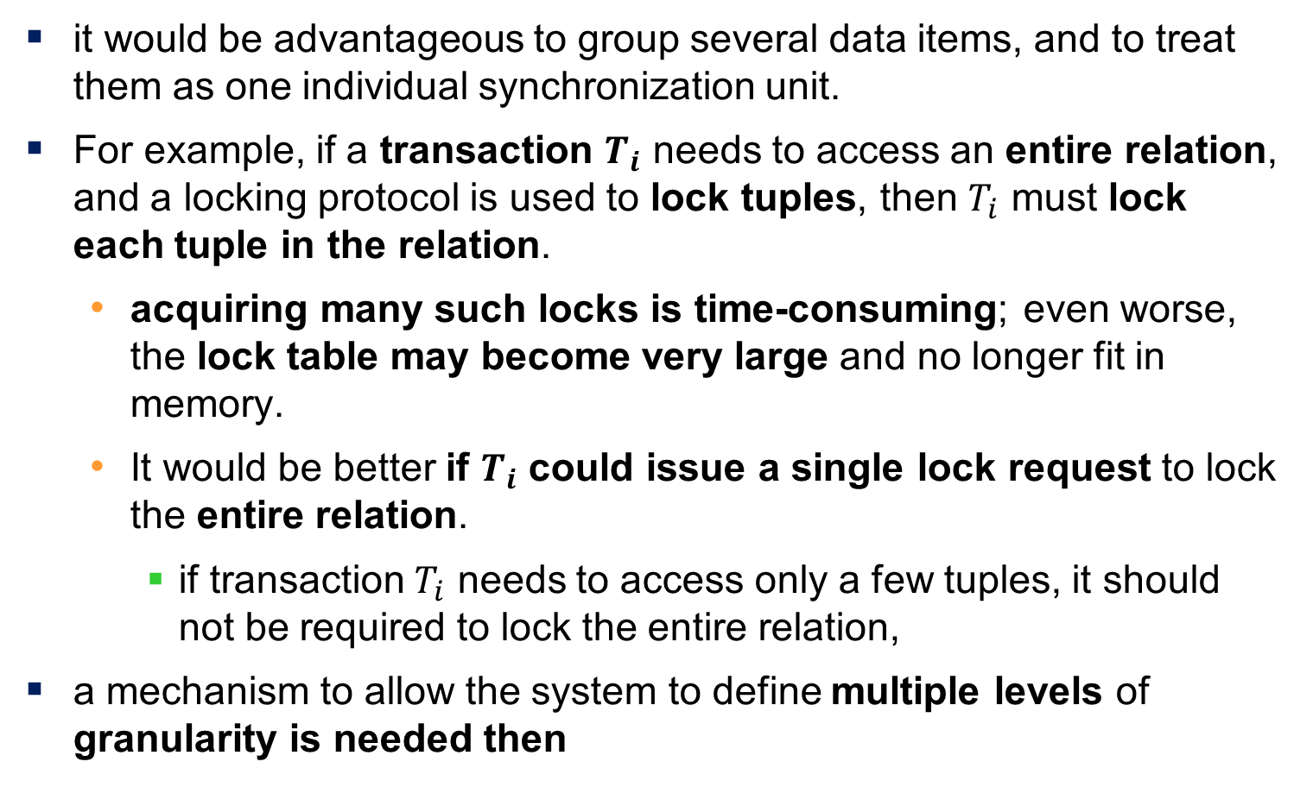
Multiple Granularity
it would be advantageous to group several data items, and to treat them as one individual synchronization unit.
For example, if a transaction $T_{i}$ needs to access an entire relation, and a locking protocol is used to lock tuples, then $T_{i}$ must lock each tuple in the relation.
acquiring many such locks is time-consuming; even worse, the lock table may become very large and no longer fit in memory.
It would be better if $T_{i}$ could issue a single lock request to lock the entire relation.
if transaction $T_{i}$ needs to access only a few tuples, it should not be required to lock the entire relation,
a mechanism to allow the system to define multiple levels of granularity is needed then
Notes:
There are circumstances, however, where it would be advantageous to group several data items, and to treat them as one individual synchronization unit. For example, if a transaction Ti needs to access an entire relation, and a locking protocol is used to lock tuples, then Ti must lock each tuple in the relation. Clearly, acquiring many such locks is time-consuming; even worse, the lock table may become very large and no longer fit in memory. It would be better if Ti could issue a single lock request to lock the entire relation. On the other hand, if transaction Tj needs to access only a few tuples, it should not be required to lock the entire relation, since otherwise concurrency is lost.
شرایطی وجود دارد که در آن گروه بندی چندین مورد از داده ها و رفتار با آنها به عنوان یک واحد همگام سازی (synchronization unit) منفرد مفید خواهد بود. به عنوان مثال، اگر تراکنش Ti نیاز به دسترسی به کل یک رابطه (relation) داشته باشد و از یک پروتکل قفل کردن برای قفل کردن تاپل ها (tuple) استفاده شود، Ti باید هر تاپل موجود در رابطه را قفل کند. بدیهی است که به دست آوردن تعداد زیادی از چنین قفل‌هایی زمان‌بر است؛ حتی بدتر اینکه، جدول قفل ممکن است بسیار بزرگ شود و دیگر در حافظه جای نگیرد. بهتر است اگر Ti بتواند یک درخواست قفل واحد برای قفل کردن کل رابطه ارسال کند. از طرف دیگر، اگر تراکنش Tj فقط به چند تاپل نیاز داشته باشد، نباید کل رابطه را قفل کند، زیرا در غیر این صورت رقابت‌پذیری (concurrency) از بین می‌رود.

Slide 39
Multiple Granularity
Allow data items to be of various sizes and define a hierarchy of data granularities, where the small granularities are nested within larger ones
Can be represented graphically as a tree (but do not confuse with tree-locking protocol)
When a transaction locks a node in the tree explicitly, it implicitly locks all the node's descendants in the same mode.
Granularity of locking (level in tree where locking is done):
Fine granularity (lower in tree): high concurrency, high locking overhead
Coarse granularity (higher in tree): low locking overhead, low concurrency
Notes:
اجازه دهید اقلام داده‌ای اندازه‌های مختلفی داشته باشند و سلسله مراتبی از دانه‌بندی داده را تعریف کنید، جایی که دانه‌بندی‌های کوچک‌تر در داخل موارد بزرگ‌تر قرار می‌گیرند.
قابل نمایش گرافیکی به صورت درخت (اما با پروتکل قفل کردن درخت اشتباه نگیرید)
هنگامی که یک تراکنش به طور صریح یک گره در درخت را قفل می‌کند، به طور ضمنی تمام فرزندان گره را در همان حالت قفل می‌کند.
دانه‌بندی قفل (سطح در درخت که قفل کردن انجام می‌شود):
دانه‌بندی ریز (پایین‌تر در درخت): همزمانی بالا، سربار قفل کردن بالا
دانه‌بندی درشت (بالاتر در درخت): سربار قفل کردن پایین، همزمانی پایین

Slide 40
Example of Granularity Hierarchy
The levels, starting from the coarsest (top) level are
database
area
file
record
Notes:
سطوح، با درشت‌ترین (بالا) سطح شروع می‌شوند:
پایگاه داده (database)
ناحیه (area)
پرونده (file)
رکورد (record)

Slide 41

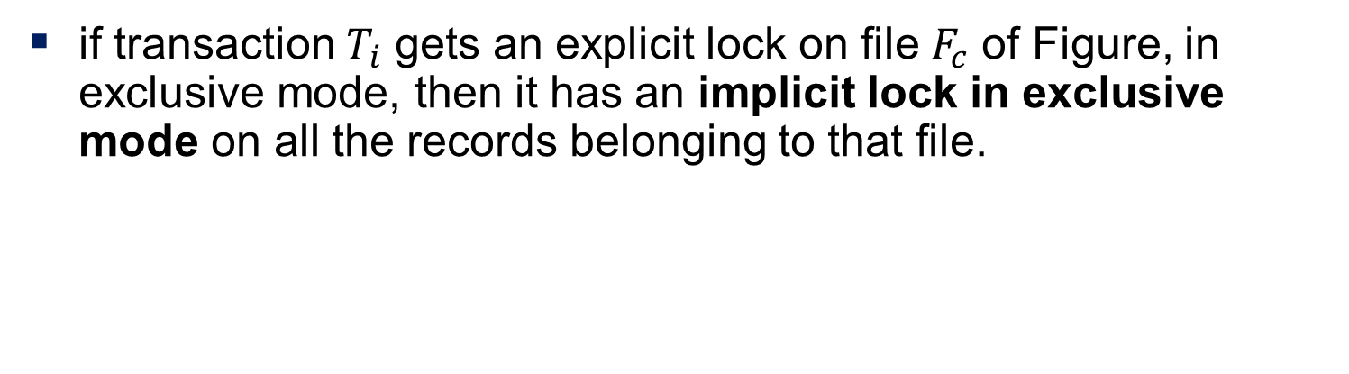

Example of Granularity Hierarchy
if transaction $T_{i}$ gets an explicit lock on file $F_{c}$ of Figure, in exclusive mode, then it has an implicit lock in exclusive mode on all the records belonging to that file.
Notes:
the tree that we describe here is significantly different from that used by the tree protocol .
A non-leaf node of the multiple-granularity tree represents the data associated with its descendants. In the tree protocol, each node is an independent data item.
In the figure, it consists of four levels of nodes. The highest level represents the entire database. Below it are nodes of type area; the database consists of exactly these areas. Each area in turn has nodes of type file as its children. Each area contains exactly those files that are its child nodes. No file is in more than one area. Finally, each file has nodes of type record. As before, the file consists of exactly those records that are its child nodes, and no record can be present in more than one file
When a transaction locks a node, in either shared or exclusive mode, the transaction also has implicitly (without ever expressing so clearly) locked all the descendants of that node in the same lock mode. For example, if transaction Ti gets an explicit lock on file Fc of Figure 18.15, in exclusive mode, then it has an implicit lock in exclusive mode on all the records belonging to that file. It does not need to lock the individual records of Fc explicitly.
How does the system determine whether Tj can lock rb6 ? Tj must traverse the tree from the root to record rb6 . If any node in that path is locked in an incompatible mode, then Tj must be delayed.

Slide 42
Example of Granularity Hierarchy
How does the system determine if the root node can be locked?
One possibility is for it to search the entire tree.
This solution, is not suitable
A more efficient way: a new class of lock modes, called intention lock modes.
If a node is locked in an intention mode, explicit locking is done at a lower level of the tree (that is, at a finer granularity)
Intention locks are put on all the ancestors of a node before that node is locked explicitly. So a transaction does not need to search the entire tree to determine whether it can lock a node successfully
Notes:
Suppose now that transaction Tk wishes to lock the entire database. To do so, it simply must lock the root of the hierarchy. Note, however, that $T_{k}$ should not succeed in locking the root node, since $T_{i}$ is currently holding a lock on part of the tree (specifically, on file $F_{b}$).
Intention locks are put on all the ancestors of a node before that node is locked explicitly. Thus, a transaction does not need to search the entire tree to determine whether it can lock a node successfully
A transaction wishing to lock a node—say, Q—must traverse a path in the tree from the root to Q. While traversing the tree, the transaction locks the various nodes in an intention mode.

Slide 43
Intention Lock Modes
In addition to S and X lock modes, there are three additional lock modes with multiple granularity:
intention-shared (IS): indicates explicit locking at a lower level of the tree but only with shared locks.
intention-exclusive (IX): indicates explicit locking at a lower level with exclusive or shared locks
shared and intention-exclusive (SIX): if a node is locked in (SIX) mode, the subtree rooted by that node is locked explicitly in shared mode and explicit locking is being done at a lower level with exclusive-mode locks.
Intention locks allow a higher level node to be locked in S or X mode without having to check all descendent nodes.
Notes:
قفل اشتراک intention (IS): دلالت بر قفل صریح در سطح پایین‌تر درخت دارد، اما تنها با قفل‌های اشتراکی.
قفل انحصاری intention (IX): نشان‌دهنده قفل صریح در سطح پایین‌تر با قفل‌های انحصاری یا اشتراکی.
قفل اشتراکی و انحصاری intention (SIX): زیر درخت ریشه‌دار توسط آن گره به صورت صریح در حالت اشتراکی قفل شده است و قفل صریح در سطح پایین‌تر با قفل‌های حالت انحصاری انجام می‌شود.
قفل‌های intention به یک گره سطح بالاتر اجازه می‌دهند تا بدون نیاز به بررسی همه گره‌های پایین‌دست، در حالت S یا X قفل شود

Slide 44
Compatibility Matrix with Intention Lock Modes
The compatibility matrix for all lock modes is:
Notes:
intention-shared (IS): indicates explicit locking at a lower level of the tree but only with shared locks.
intention-exclusive (IX): indicates explicit locking at a lower level with exclusive or shared locks
shared and intention-exclusive (SIX)

Slide 45
Multiple Granularity Locking Scheme
Transaction T_{i} can lock a node Q, using the following rules:
The lock compatibility matrix must be observed.
2. The root of the tree must be locked first, and may be locked in any
mode.
3. A node Q can be locked by T_{i} in S or IS mode only if the parent of Q is
currently locked by T_{i} in either IX or IS mode.
4. A node Q can be locked by T_{i} in X, SIX, or IX mode only if the parent
of Q is currently locked by T_{i} in either IX or SIX mode.
5. T_{i} can lock a node only if it has not previously unlocked any node (that
is, T_{i} is two-phase).
6. T_{i} can unlock a node Q only if none of the children of Q are currently
locked by T_{i}.
Observe that locks are acquired in root-to-leaf order, whereas they are released in leaf-to-root order.
Lock granularity escalation: in case there are too many locks at a particular level, switch to higher granularity S or X lock
Notes:
The number of locks that an SQL query may need to acquire can usually be estimated based on the relation scan operations performed by a query. A relation scan, for example, would acquire a lock at a relation level, while an index scan that is expected to fetch only a few records may acquire an intention lock at the relation level and regular locks at the tuple level. In case the a transaction acquires a large number of tuple locks, the lock table may become overfull. To deal with this situation, the lock manager may perform lock escalation, replacing many lower level locks by a single higher level lock; in our example, a single relation lock could replace a large number of tuple locks.

Slide 46

Multiple Granularity Locking Scheme
Suppose that transaction T21 reads record ${r_{a}}_{2}$ in file $F_{a}$ . Then, T21 needs to lock the database, area $A_{1}$, and $F_{a}$ in IS mode (and in that order), and finally to lock ${r_{a}}_{2}$ in S mode.
Suppose that transaction T22 modifies record ${r_{a}}_{9}$ in file $F_{a}$. Then, T22 needs to lock the database, area A1, and file $F_{a}$ (and in that order) in IX mode, and finally to lock ${r_{a}}_{9}$in X mode.
Notes:
We note that transactions T21, T23, and T24 can access the database concurrently. Transaction T22 can execute concurrently with T21, but not with either T23 or T24.

Slide 47

Multiple Granularity Locking Scheme
Suppose that transaction T23 reads all the records in file $F_{a}$. Then, T23 needs to lock the database and area A1 (and in that order) in IS mode, and finally to lock $F_{a}$in S mode.
Suppose that transaction T24 reads the entire database. It can do so after locking the database in S mode.
Notes:
We note that transactions T21, T23, and T24 can access the database concurrently. Transaction T22 can execute concurrently with T21, but not with either T23 or T24.
This protocol enhances concurrency and reduces lock overhead. It is particularly useful in applications that include a mix of:
• Short transactions that access only a few data items.
• Long transactions that produce reports from an entire file or set of files.

Slide 48
Timestamp Based Concurrency Control

Slide 49
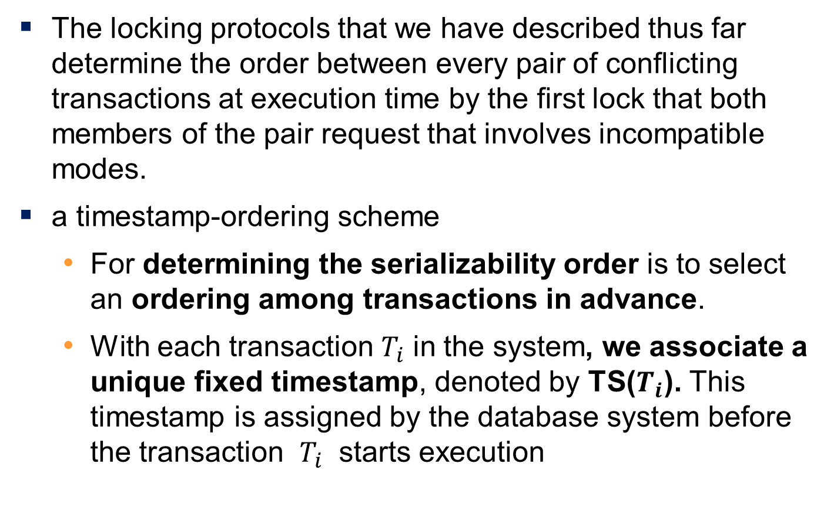
Timestamp Based Concurrency Control
The locking protocols that we have described thus far determine the order between every pair of conflicting transactions at execution time by the first lock that both members of the pair request that involves incompatible modes.
a timestamp-ordering scheme
For determining the serializability order is to select an ordering among transactions in advance.
With each transaction $T_{i}$ in the system, we associate a unique fixed timestamp, denoted by TS($T_{i}$). This timestamp is assigned by the database system before the transaction $T_{i}$ starts execution
Notes:
If a transaction Ti has been assigned timestamp TS(Ti ), and a new transaction Tj enters the system, then TS(Ti ) < TS(Tj )

Slide 50
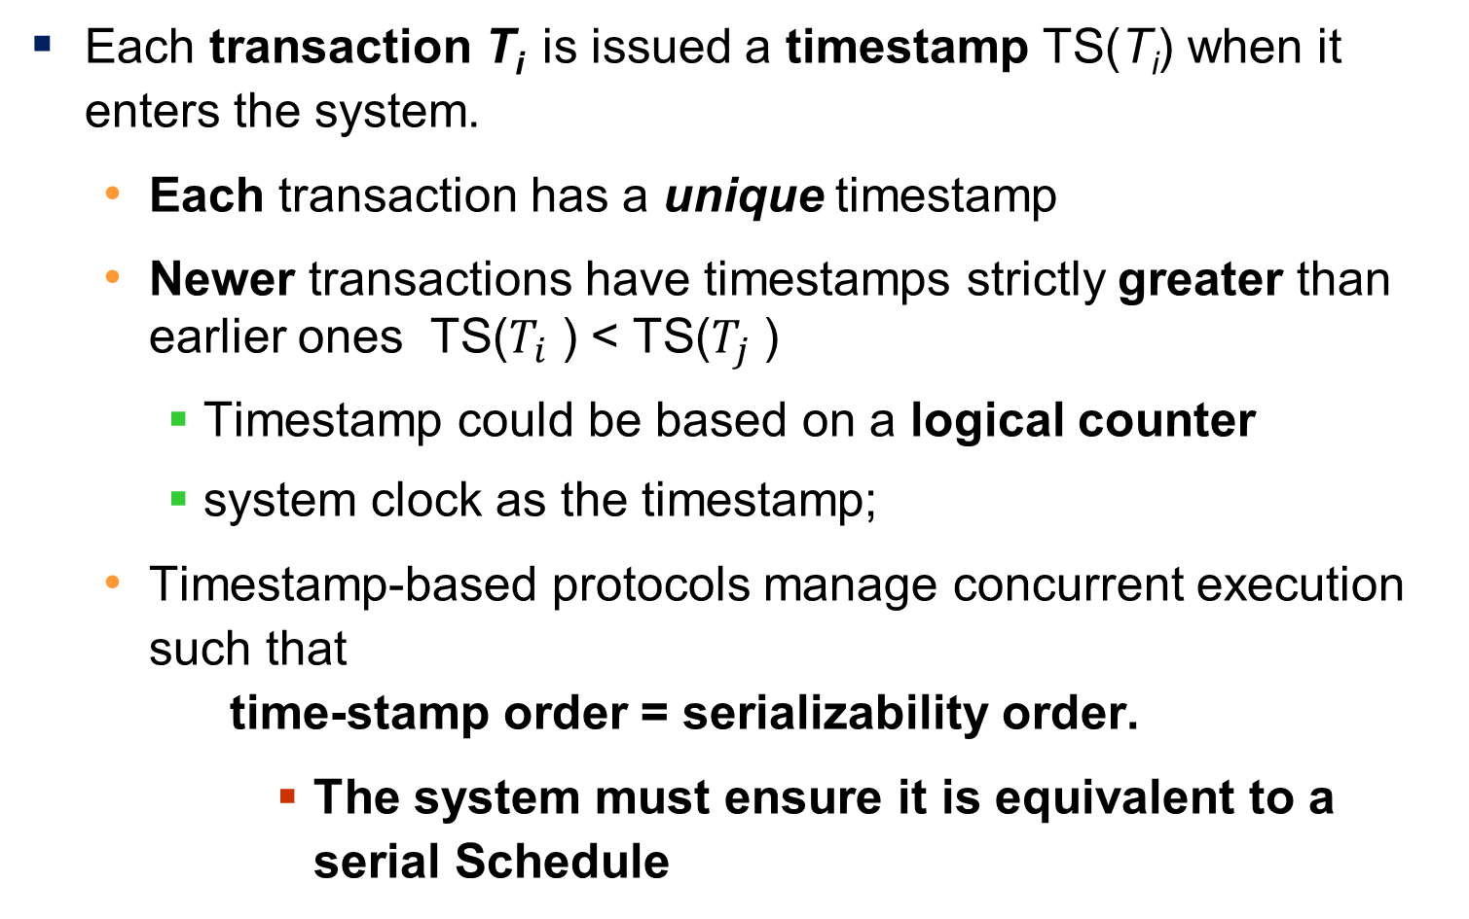
Timestamp-Based Protocols
Each transaction T_{i} is issued a timestamp TS(T_{i}) when it enters the system.
Each transaction has a unique timestamp
Newer transactions have timestamps strictly greater than earlier ones TS($T_{i}$ ) < TS($T_{j}$ )
Timestamp could be based on a logical counter
system clock as the timestamp;
Timestamp-based protocols manage concurrent execution such that time-stamp order = serializability order.
The system must ensure it is equivalent to a serial Schedule
Notes:
The timestamps of the transactions determine the serializability order. Thus, if TS(Ti ) < TS(Tj ), then the system must ensure that the produced schedule is equivalent to a serial schedule in which transaction Ti appears before transaction Tj .

Slide 51
Timestamp-Ordering Protocol
The timestamp ordering (TSO) protocol
Maintains for each data Q two timestamp values:
W-timestamp(Q) is the largest time-stamp of any transaction that executed write(Q) successfully.
R-timestamp(Q) is the largest time-stamp of any transaction that executed read(Q) successfully.
Imposes rules on read and write operations to ensure that
Any conflicting operations are executed in timestamp order
Out of order operations cause transaction rollback
Notes:
then the system must ensure that the produced schedule is equivalent to a serial schedule in which transaction Ti appears before transaction Tj .

Slide 52
Timestamp-Based Protocols (Cont.)
Suppose a transaction T_{i} issues a read(Q)
1. If TS(T_{i}) < W-timestamp(Q), then T_{i} needs to read a value of Q that
was already overwritten.
Hence, the read operation is rejected, and T_{i} is rolled back.
If TS(T_{i}) ≥ W-timestamp(Q), then the read operation is executed, and
R-timestamp(Q) is set to =max(R-timestamp(Q), TS(T_{i})).

Slide 53
Timestamp-Based Protocols (Cont.)
Suppose that transaction T_{i} issues write(Q).
1. If TS(T_{i}) < R-timestamp(Q), then the value of Q that T_{i} is producing
was needed previously, and the system assumed that that value
would never be produced.
Hence, the write operation is rejected, and T_{i} is rolled back.
2. If TS(T_{i}) < W-timestamp(Q), then T_{i} is attempting to write an
obsolete value of Q.
Hence, this write operation is rejected, and T_{i} is rolled back.
3. Otherwise, the write operation is executed, and W-timestamp(Q) is
set to TS(T_{i}).
Notes:
فرض کنید تراکنش Ti دستور write(Q) را صادر می کند. 1. اگر TS(Ti) < R-timestamp(Q)، به این معنی است که مقداری از Q که Ti تولید می کند قبلا مورد نیاز بوده است، و سیستم فرض کرده است که آن مقدار هرگز تولید نخواهد شد. Ø بنابراین، عملیات نوشتن رد می شود و Ti لغو می شود. 2. اگر TS(Ti) < W-timestamp(Q)، به این معنی است که Ti در حال تلاش برای نوشتن مقدار قدیمی Q است. Ø بنابراین، این عملیات نوشتن رد می شود و Ti لغو می شود. 3. در غیر این صورت، عملیات نوشتن اجرا می شود و W-timestamp(Q) روی TS(Ti) تنظیم می شود.

Slide 54
Timestamp-Based Protocols (Cont.)
If a transaction T_{i} is rolled back by the concurrency-control scheme as result of issuance of either a read or write operation, the system assigns it a new timestamp and restarts it.
Notes:
فرض کنید تراکنش Ti دستور write(Q) را صادر می کند. 1. اگر TS(Ti) < R-timestamp(Q)، به این معنی است که مقداری از Q که Ti تولید می کند قبلا مورد نیاز بوده است، و سیستم فرض کرده است که آن مقدار هرگز تولید نخواهد شد. Ø بنابراین، عملیات نوشتن رد می شود و Ti لغو می شود. 2. اگر TS(Ti) < W-timestamp(Q)، به این معنی است که Ti در حال تلاش برای نوشتن مقدار قدیمی Q است. Ø بنابراین، این عملیات نوشتن رد می شود و Ti لغو می شود. 3. در غیر این صورت، عملیات نوشتن اجرا می شود و W-timestamp(Q) روی TS(Ti) تنظیم می شود.

Slide 55
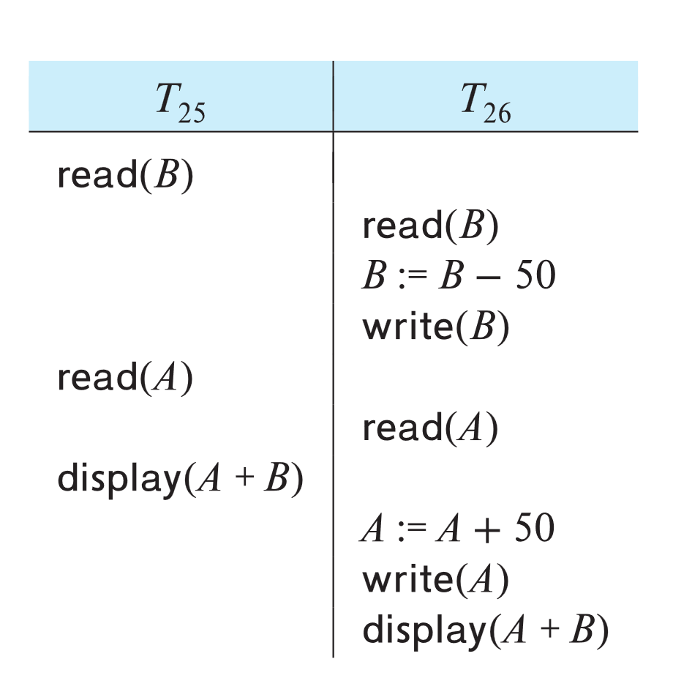
Example of Schedule Under TSO
Is this schedule valid under TSO?
We consider transactions T25 and T26. Transaction T25 displays the contents of accounts A + B
Transaction T26 transfers $50 from account B to account A, and then displays the contents of both
Assume that initially:
R-TS(A) = W-TS(A) = 0
R-TS(B) = W-TS(B) = 0
Assume TS(T₂₅) = 25 and TS(T₂₆) = 26
Notes:
TS(T25) < TS(T26), and the schedule is possible under the timestamp protocol.
We note that the preceding execution can also be produced by the two-phase locking protocol. There are, however, schedules that are possible under the two-phase locking protocol
The timestamp-ordering protocol ensures conflict serializability. This is because conflicting operations are processed in timestamp order.

Slide 56
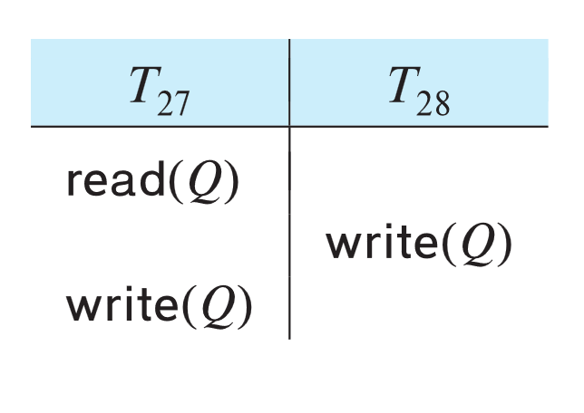
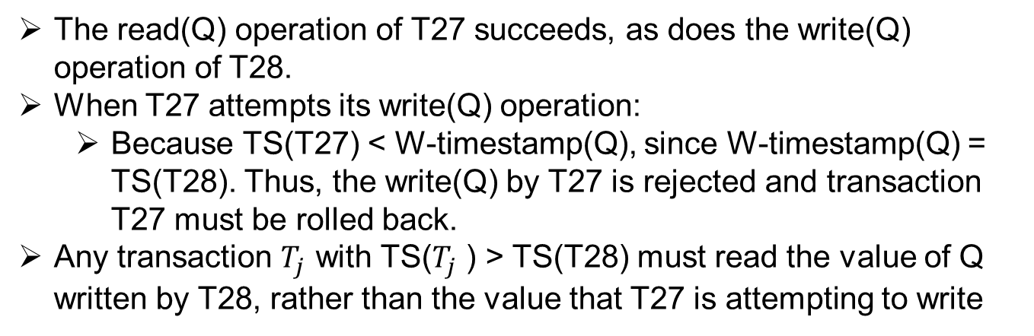
Example of Schedule Under TSO
Is this schedule valid under TSO?
How about this one, where initially
R-TS(Q)=W-TS(Q)=0
TS(T27) < TS(T28)
The read(Q) operation of T27 succeeds, as does the write(Q) operation of T28.
When T27 attempts its write(Q) operation:
Because TS(T27) < W-timestamp(Q), since W-timestamp(Q) = TS(T28). Thus, the write(Q) by T27 is rejected and transaction T27 must be rolled back.
Any transaction $T_{j}$ with TS($T_{j}$ ) > TS(T28) must read the value of Q written by T28, rather than the value that T27 is attempting to write
Notes:
عملیات read(Q) تراکنش T27 و همچنین عملیات write(Q) تراکنش T28 با موفقیت انجام می شوند.
اما زمانی که T27 تلاش به انجام عملیات write(Q) می کند، مشاهده می کنیم که TS(T27) < W-timestamp(Q)، زیرا W-timestamp(Q) = TS(T28). بنابراین، عملیات write(Q) توسط T27 رد شده و تراکنش T27 باید لغو شود (Rollback).
اگرچه لغو T27 طبق پروتکل مرتب سازی بر اساس زمان‌بندی الزامی است، اما در واقع غیر ضروری است. از آنجایی که T28 قبلاً Q را نوشته است، مقداری که T27 در حال تلاش برای نوشتن است، مقداری است که دیگر هرگز نیاز به خواندن ندارد. هر تراکنشی با TS(Ti) < TS(T28) که تلاش به خواندن read(Q) کند، لغو خواهد شد، زیرا TS(Ti) < W-timestamp(Q). هر تراکنشی با TS(Tj) > TS(T28) باید مقدار Q نوشته شده توسط T28 را بخواند، به جای مقداری که T27 در حال تلاش برای نوشتن آن است.

Slide 57
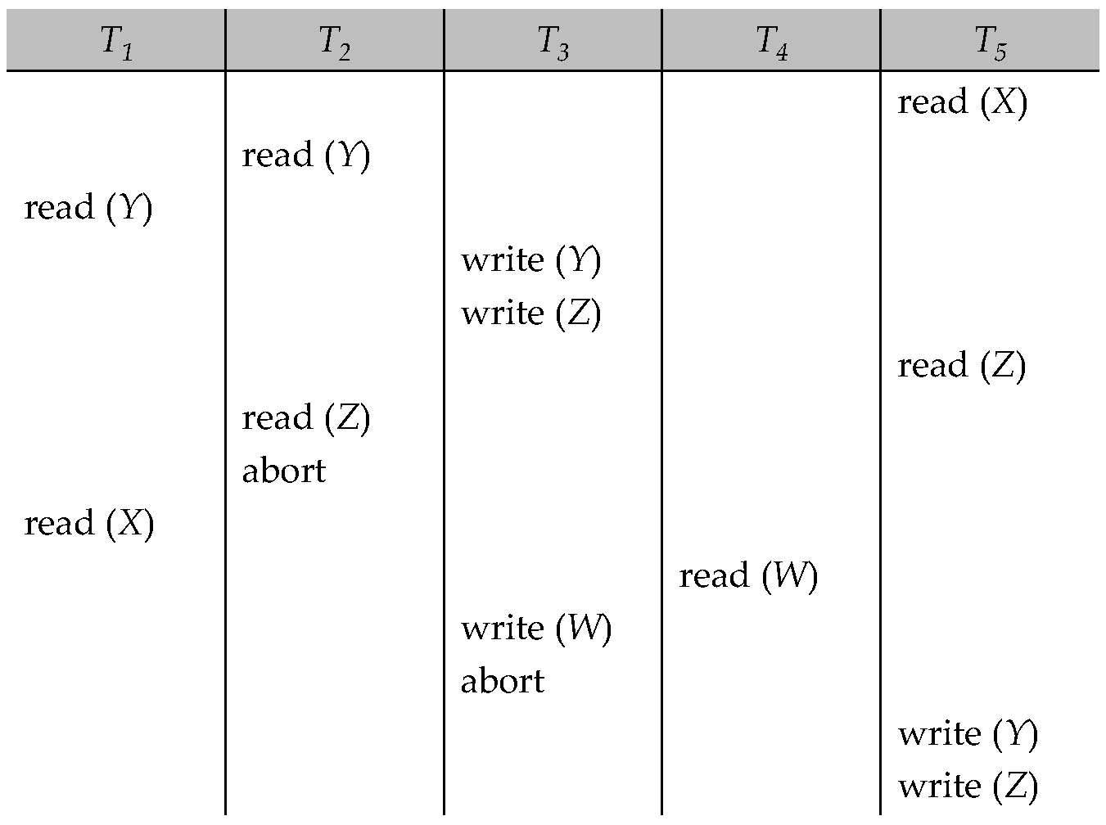
Another Example Under TSO
A partial schedule for several data items for transactions with
timestamps 1, 2, 3, 4, 5, with all R-TS and W-TS = 0 initially

Slide 58
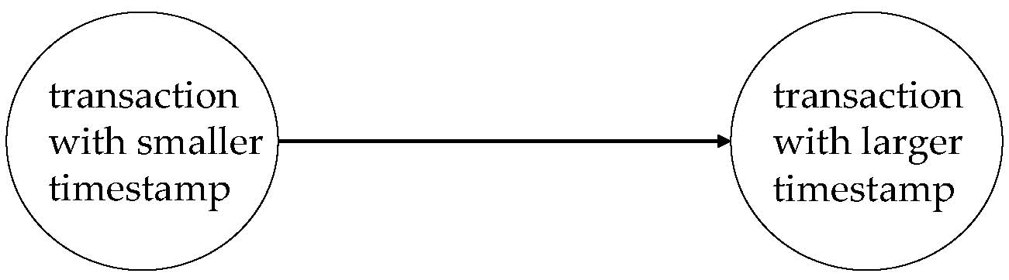
Correctness of Timestamp-Ordering Protocol
The timestamp-ordering protocol guarantees serializability since all the arcs in the precedence graph are of the form:
Thus, there will be no cycles in the precedence graph
Timestamp protocol ensures freedom from deadlock as no transaction ever waits.
But the schedule may not be cascade-free, and may not even be recoverable.
Notes:
Solution 1:
A transaction is structured such that its writes are all performed at the end of its processing
All writes of a transaction form an atomic action; no transaction may execute while a transaction is being written
A transaction that aborts is restarted with a new timestamp
Solution 2:
Limited form of locking: wait for data to be committed before reading it
Solution 3:
Use commit dependencies to ensure recoverability

Slide 59
Recoverability and Cascade Freedom
Solution 1:
A transaction is structured such that its writes are all performed at the end of its processing
All writes of a transaction form an atomic action; no transaction may execute while a transaction is being written
A transaction that aborts is restarted with a new timestamp
Solution 2:
Limited form of locking: wait for data to be committed before reading it
Solution 3:
Use commit dependencies to ensure recoverability

Slide 60
Thomas’ Write Rule
Modified version of the timestamp-ordering protocol in which obsolete write operations may be ignored under certain circumstances.
When T_{i} attempts to write data item Q, if TS(T_{i}) < W-timestamp(Q), then T_{i} is attempting to write an obsolete value of {Q}.
Rather than rolling back T_{i} as the timestamp ordering protocol would have done, this {write} operation can be ignored.
Otherwise this protocol is the same as the timestamp ordering protocol.
Thomas' Write Rule allows greater potential concurrency.
Allows some view-serializable schedules that are not conflict-serializable.

Slide 61
Validation-Based Protocol
Idea: can we use commit time as serialization order?
To do so:
Postpone writes to end of transaction
Keep track of data items read/written by transaction
Validation performed at commit time, detect any out-of-serialization order reads/writes
Also called as optimistic concurrency control since transaction executes fully in the hope that all will go well during validation

Slide 62
Validation-Based Protocol
Execution of transaction T_{i} is done in three phases.
1. Read and execution phase: Transaction T_{i} writes only to
temporary local variables
2. Validation phase: Transaction T_{i} performs a '‘validation test''
to determine if local variables can be written without violating
serializability.
3. Write phase: If T_{i} is validated, the updates are applied to the
database; otherwise, T_{i} is rolled back.
The three phases of concurrently executing transactions can be interleaved, but each transaction must go through the three phases in that order.
We assume for simplicity that the validation and write phase occur together, atomically and serially
I.e., only one transaction executes validation/write at a time.

Slide 63
Validation-Based Protocol (Cont.)
Each transaction T_{i} has 3 timestamps
StartTS(T_{i}) : the time when T_{i} started its execution
ValidationTS(T_{i}): the time when T_{i} entered its validation phase
FinishTS(T_{i}) : the time when T_{i} finished its write phase
Validation tests use above timestamps and read/write sets to ensure that serializability order is determined by validation time
Thus, TS(T_{i}) = ValidationTS(T_{i})
Validation-based protocol has been found to give greater degree of concurrency than locking/TSO if probability of conflicts is low.

Slide 64
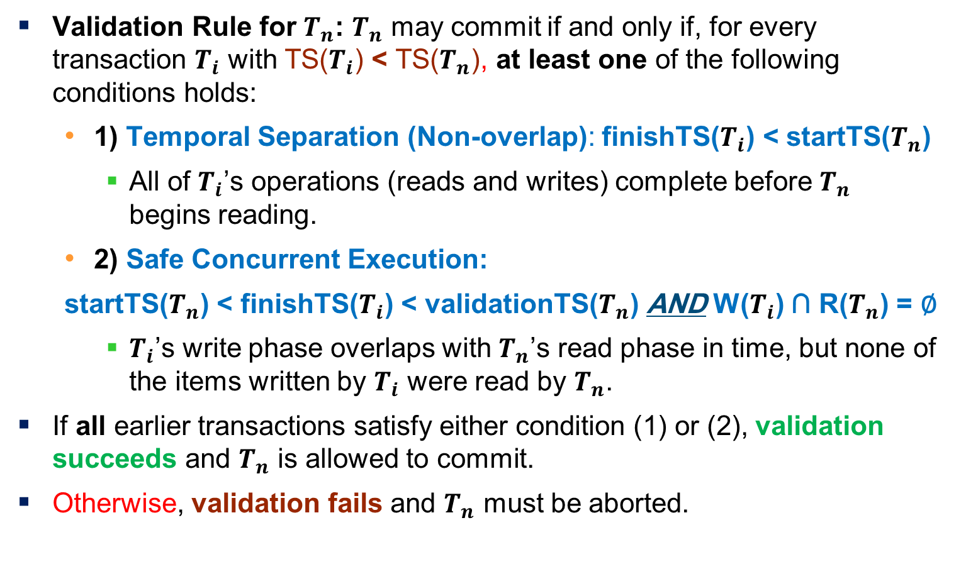
Validation Test for Transaction T_{j}
Validation Rule for $T_{n}$: $T_{n}$ may commit if and only if, for every transaction $T_{i}$ with TS($T_{i}$) < TS($T_{n}$), at least one of the following conditions holds:
1) Temporal Separation (Non‑overlap): finishTS($T_{i}$) < startTS($T_{n}$)
All of $T_{i}$’s operations (reads and writes) complete before $T_{n}$ begins reading.
2) Safe Concurrent Execution:
startTS($T_{n}$) < finishTS($T_{i}$) < validationTS($T_{n}$) AND W($T_{i}$) ∩ R($T_{n}$) = ∅
$T_{i}$’s write phase overlaps with $T_{n}$’s read phase in time, but none of the items written by $T_{i}$ were read by $T_{n}$.
If all earlier transactions satisfy either condition (1) or (2), validation succeeds and $T_{n}$ is allowed to commit.
Otherwise, validation fails and $T_{n}$ must be aborted.
Notes:
Justification:
First condition applies when execution is not concurrent
The writes of T_{j} do not affect reads of T_{i} since they occur after T_{i} has finished its reads.
If the second condition holds, execution is concurrent, T_{j} does not read any item written by T_{i}.

Slide 65
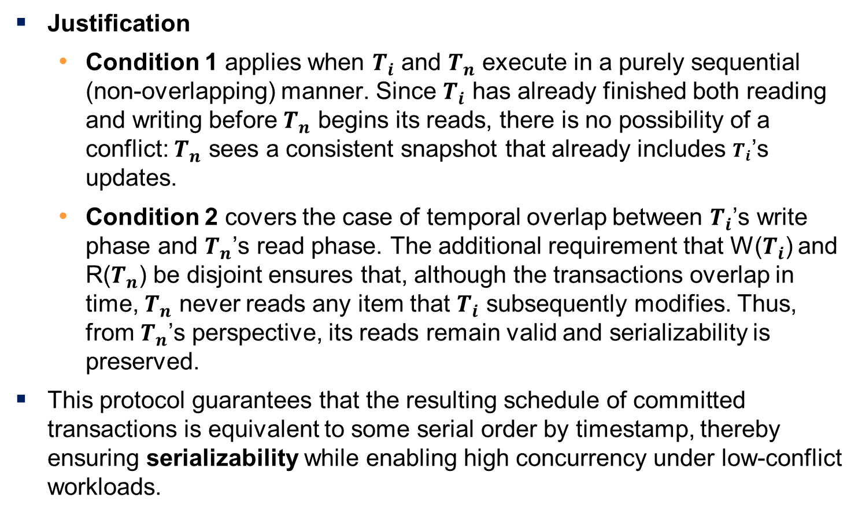
Validation Test for Transaction T_{j}
Justification
Condition 1 applies when $T_{i}$ and $T_{n}$ execute in a purely sequential (non‑overlapping) manner. Since $T_{i}$ has already finished both reading and writing before $T_{n}$ begins its reads, there is no possibility of a conflict: $T_{n}$ sees a consistent snapshot that already includes $T_{i}$’s updates.
Condition 2 covers the case of temporal overlap between $T_{i}$’s write phase and $T_{n}$’s read phase. The additional requirement that W($T_{i}$) and R($T_{n}$) be disjoint ensures that, although the transactions overlap in time, $T_{n}$ never reads any item that $T_{i}$ subsequently modifies. Thus, from $T_{n}$’s perspective, its reads remain valid and serializability is preserved.
This protocol guarantees that the resulting schedule of committed transactions is equivalent to some serial order by timestamp, thereby ensuring serializability while enabling high concurrency under low-conflict workloads.
Notes:
Justification:
First condition applies when execution is not concurrent
The writes of T_{j} do not affect reads of T_{i} since they occur after T_{i} has finished its reads.
If the second condition holds, execution is concurrent, T_{j} does not read any item written by T_{i}.

Slide 66
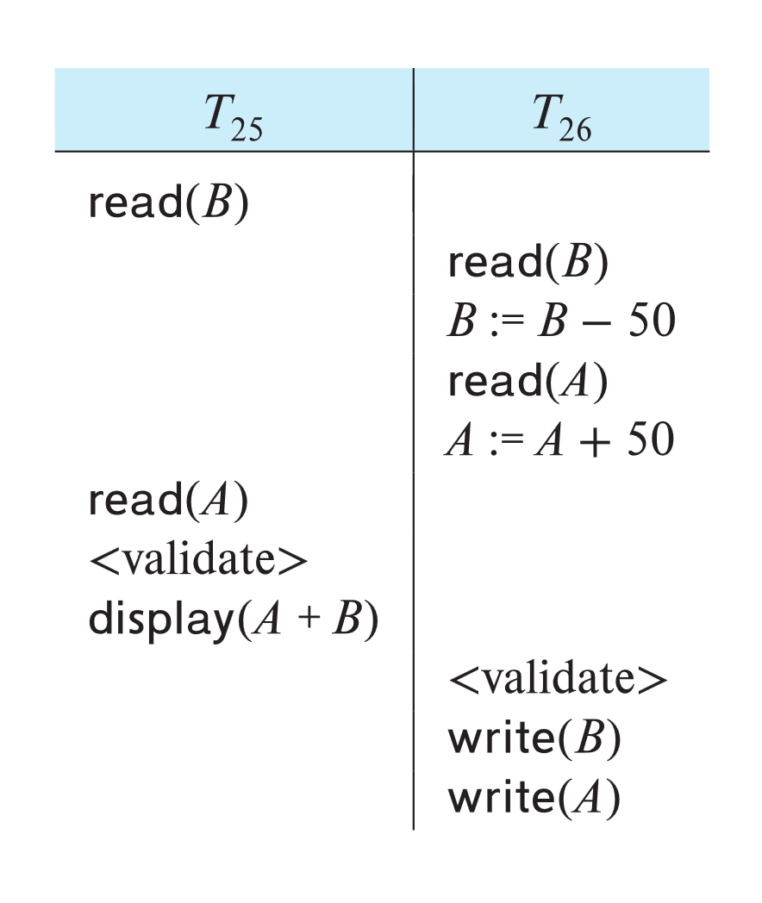
Schedule Produced by Validation
Example of schedule produced using validation
Suppose that TS(T25) < TS(T26).
The validation phase succeeds in the schedule.
Note that the writes to the actual variables are performed only after the validation phase of T26. Thus, T25 reads the old values of B and A, and this schedule is serializable.
Notes:
طرح اعتبارسنجی به طور خودکار از بازگشت‌های آبشاری (Cascading Rollbacks) جلوگیری می‌کند، زیرا نوشته‌های واقعی تنها پس از انجام (Commit) تراکنشی که دستور نوشتن را صادر کرده است، انجام می‌گیرد.
ولی به دلیل توالی تراکنش‌های کوتاه متضاد که باعث راه‌اندازی مجدد مکرر تراکنش طولانی می‌شوند، احتمال گرسنگی (Starvation) برای تراکنش‌های طولانی وجود دارد. برای جلوگیری از گرسنگی، تراکنش‌های متضاد باید به طور موقت مسدود شوند تا تراکنش طولانی بتواند به پایان برسد.
The validation scheme automatically guards against cascading rollbacks, since the actual writes take place only after the transaction issuing the write has committed.
However, there is a possibility of starvation of long transactions, due to a sequence of conflicting short transactions that cause repeated restarts of the long transaction. To avoid starvation, conflicting transactions must be temporarily blocked to enable the long transaction to finish

Slide 67
Part 2.

Slide 68
Multiversion Concurrency Control

Slide 69
Multiversion Schemes
Multiversion schemes keep old versions of data item to increase concurrency. Several variants:
Multiversion Timestamp Ordering
Multiversion Two-Phase Locking
Snapshot isolation
Key ideas:
Each successful write results in the creation of a new version of the data item written.
Use timestamps to label versions.
When a read(Q) operation is issued, select an appropriate version of Q based on the timestamp of the transaction issuing the read request, and return the value of the selected version.
reads never have to wait as an appropriate version is returned immediately.

Slide 70
Multiversion Timestamp Ordering
Each data item Q has a sequence of versions <Q₁, Q₂,...., Q_{m}>. Each version Q_{k} contains three data fields:
Content -- the value of version Q_{k}.
W-timestamp(Q_{k}) -- timestamp of the transaction that created (wrote) version Q_{k}
R-timestamp(Q_{k}) -- largest timestamp of a transaction that successfully read version Q_{k}

Slide 71
Multiversion Timestamp Ordering (Cont)
Suppose that transaction T_{i} issues a read(Q) or write(Q) operation.
Let Q_{k} denote the version of Q whose write timestamp is the largest write timestamp less than or equal to TS(T_{i}).
1. If transaction T_{i} issues a read(Q), then
the value returned is the content of version Q_{k}
If R-timestamp(Q_{k}) < TS(T_{i}), set R-timestamp(Q_{k}) = TS(T_{i}),
2. If transaction T_{i} issues a write(Q)
if TS(T_{i}) < R-timestamp(Q_{k}), then transaction T_{i} is rolled back.
if TS(T_{i}) = W-timestamp(Q_{k}), the contents of Q_{k} are overwritten
Otherwise, a new version Q_{i} of Q is created
W-timestamp(Q_{i}) and R-timestamp(Q_{i}) are initialized to TS(T_{i}).

Slide 72
Multiversion Timestamp Ordering (Cont)
Observations
Reads always succeed
A write by T_{i} is rejected if some other transaction T_{j} that (in the serialization order defined by the timestamp values) should read T_{i}'s write, has already read a version created by a transaction older than T_{i}.
Protocol guarantees serializability
Notes:
Key Observations:
Reads always succeed: Transactions reading data can always find a valid version to read—either the latest committed version or an older one that fits the transaction’s timestamp ordering.
Write rejection condition: If a transaction Ti tries to write a new version of a data item, the protocol checks whether any transaction Tj, which should logically read Ti's write (based on the timestamp order), has already read an older version created before Ti. If this happens, Ti's write is rejected to prevent violating the serialization order.

Slide 73
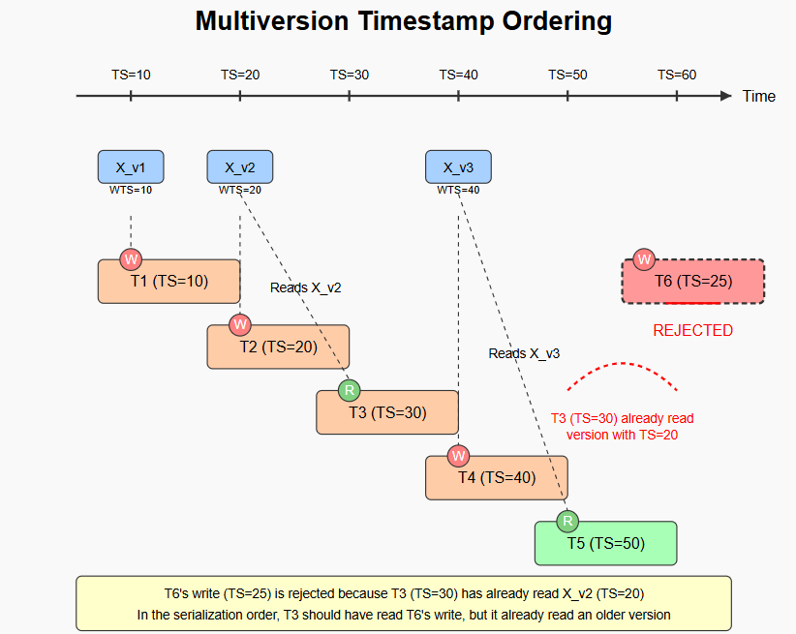
Notes:
This SVG visualization explains multiversion timestamp ordering (MVTO) concurrency control with the specific constraints you mentioned. Here's what's happening in the image:
Key Elements of the Visualization:
Timeline and Timestamps: The horizontal timeline shows transaction timestamps from 10 to 60.
Object Versions: Multiple versions of object X are maintained (X_v1, X_v2, X_v3) with their Write Timestamp (WTS).
Transactions: Five active transactions (T1-T5) with timestamps 10, 20, 30, 40, and 50.
Operations:
Write operations (W in red circles)
Read operations (R in green circles)
Rejected Transaction: T6 with timestamp 25 is rejected (marked in red)
The Scenario Illustrated:
T1 (TS=10) writes X_v1
T2 (TS=20) writes X_v2
T3 (TS=30) reads X_v2 (the latest version with TS less than 30)
T4 (TS=40) writes X_v3
T5 (TS=50) reads X_v3 (the latest version with TS less than 50)
Why T6 is Rejected:
T6 (TS=25) tries to write a new version of X
However, T3 (TS=30) has already read X_v2 (TS=20)
According to timestamp ordering rules, T3 should have read T6's write (since 25 < 30)
But T3 already read an older version (TS=20), violating serializability
Therefore, T6's write is rejected
This illustrates your key points:
Reads always succeed (as shown by T3 and T5 reading without issues)
A write is rejected if a transaction that

Slide 74
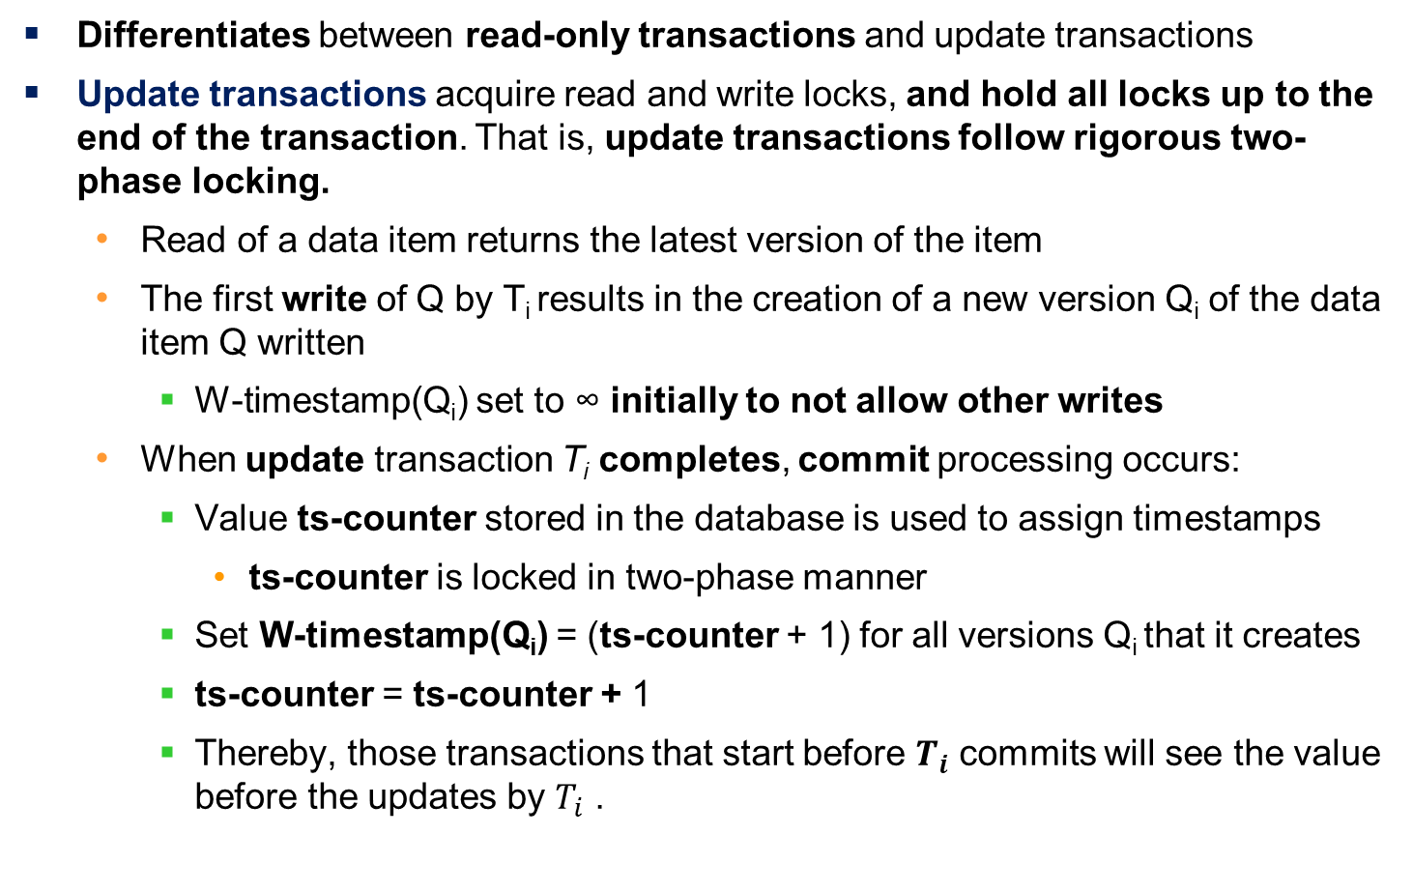
Multiversion Two-Phase Locking
Differentiates between read-only transactions and update transactions
Update transactions acquire read and write locks, and hold all locks up to the end of the transaction. That is, update transactions follow rigorous two-phase locking.
Read of a data item returns the latest version of the item
The first write of Q by T_{i} results in the creation of a new version Q_{i} of the data item Q written
W-timestamp(Q_{i}) set to ∞ initially to not allow other writes
When update transaction T_{i} completes, commit processing occurs:
Value ts-counter stored in the database is used to assign timestamps
ts-counter is locked in two-phase manner
Set W-timestamp(Q_{i}) = (ts-counter + 1) for all versions Q_{i} that it creates
ts-counter = ts-counter + 1
Thereby, those transactions that start before $T_{i}$ commits will see the value before the updates by $T_{i}$ .
Notes:
The database system assigns read-only transactions a timestamp by reading the current value of ts-counter before they start execution;
they follow the multiversion timestamp-ordering protocol for performing reads;
Thus, when a read-only transaction Ti issues a read(Q), the value returned is the contents of the version whose timestamp is the largest timestamp less than or equal to TS(Ti ).
When an update transaction reads an item, it gets a shared lock on the item and reads the latest version of that item.
When an update transaction wants to write an item, it first gets an exclusive lock on the item and then creates a new version of the data item.
Read-only transactions see the old value of ts-counter until T_i has successfully committed.

Slide 75
Multiversion Two-Phase Locking
Imagine an online store has a product P with a price history. Transactions update or read the price.
Initial State:
The product P has an initial price: $100, The timestamp counter (ts-counter) = 10.
Transactions:
Transaction T1 (Update Transaction)
Starts at ts = 11. Reads the latest price ($100).
First Write: Creates a new version P1 with price $120.
The write timestamp W-ts(P1) is set to ∞ (blocking other writes).
Commit Process:
Locks ts-counter. Sets W-ts(P1) = ts-counter + 1 → W-ts(P1) = 11. Updates ts-counter = 11.
Transaction T2 (Read-Only Transaction)
Starts at ts = 10 (before T1 commits).
Reads product P, but since T1 hasn’t committed, it sees the older price ($100).
Notes:
Outcome:
Transactions starting before T1 commits see the old price ($100).
Once T1 commits, new transactions see the updated price ($120).
MV2PL ensures consistency while allowing concurrency!

Slide 76
Multiversion Two-Phase Locking (Cont.)
Read-only transactions
are assigned a timestamp = ts-counter when they start execution
follow the multiversion timestamp-ordering protocol for performing reads
Do not obtain any locks
Read-only transactions that start after T_{i} increments ts-counter will see the values updated by T_{i}.
Read-only transactions that start before T_{i} increments the ts-counter will see the value before the updates by T_{i}.
Only serializable schedules are produced.

Slide 77
MVCC: Implementation Issues
Creation of multiple versions increases storage overhead
Extra tuples
Extra space in each tuple for storing version information
Versions can, however, be garbage collected
E.g., if Q has two versions Q5 and Q9, and the oldest active transaction has timestamp > 9, than Q5 will never be required again
Issues with
primary key and foreign key constraint checking
Indexing of records with multiple versions
See textbook for details
Notes:
multiversion concurrency control

Slide 78
Snapshot Isolation
Motivation: Decision support queries that read large amounts of data have concurrency conflicts with OLTP transactions that update a few rows
Poor performance results
Solution 1: Use multiversion 2-phase locking
Give logical “snapshot” of database state to read only transaction
Reads performed on snapshot
Update (read-write) transactions use normal locking
Works well, but how does system know a transaction is read only?
Solution 2 (partial): Give snapshot of database state to every transaction
Reads performed on snapshot
Use 2-phase locking on updated data items
Problem: variety of anomalies such as lost update can result
Better solution: snapshot isolation level (next slide)
Notes:
Online transaction processing (OLTP) and decision support, including online analytical processing (OLAP), are two broad classes of applications handled by database systems.

Slide 79
Snapshot Isolation
A transaction T1 executing with Snapshot Isolation
Takes snapshot of committed data at start
Always reads/modifies data in its own snapshot
Updates of concurrent transactions are not visible to T1
Writes of T1 complete when it commits
First-committer-wins rule:
Commits only if no other concurrent transaction has already written data that T1 intends to write.
T1 | T2 | T3
W(Y := 1) Commit
 | Start R(X) → 0 R(Y)→ 1
 |  | W(X:=2) W(Z:=3) Commit
 | R(Z) → 0 R(Y) → 1 W(X:=3) Commit-Req Abort
Concurrent updates not visible
Own updates are visible
Not first-committer of X
Serialization error, T2 is rolled back

Slide 80
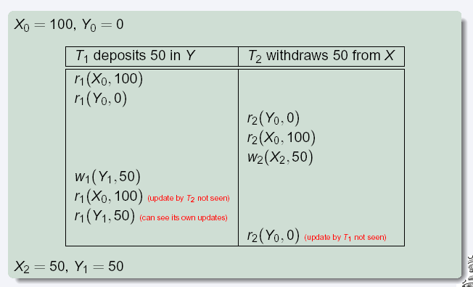
Snapshot Read
Concurrent updates invisible to snapshot read
Notes:
80

Slide 81
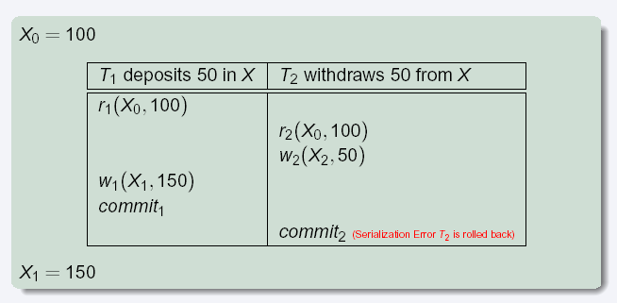
Snapshot Write: First Committer Wins
Variant: “First-updater-wins”
Check for concurrent updates when write occurs by locking item
But lock should be held till all concurrent transactions have finished
(Oracle uses this plus some extra features)
Differs only in when abort occurs, otherwise equivalent
Notes:
81

Slide 82
Benefits of SI
Reads are never blocked,
and also don’t block other txns activities
Performance similar to Read Committed
Avoids several anomalies
No dirty read, i.e. no read of uncommitted data
No lost update
I.e., update made by a transaction is overwritten by another transaction that did not see the update)
No non-repeatable read
I.e., if read is executed again, it will see the same value
Problems with SI
SI does not always give serializable executions
Serializable: among two concurrent txns, one sees the effects of the other
In SI: neither sees the effects of the other
Result: Integrity constraints can be violated

Slide 83
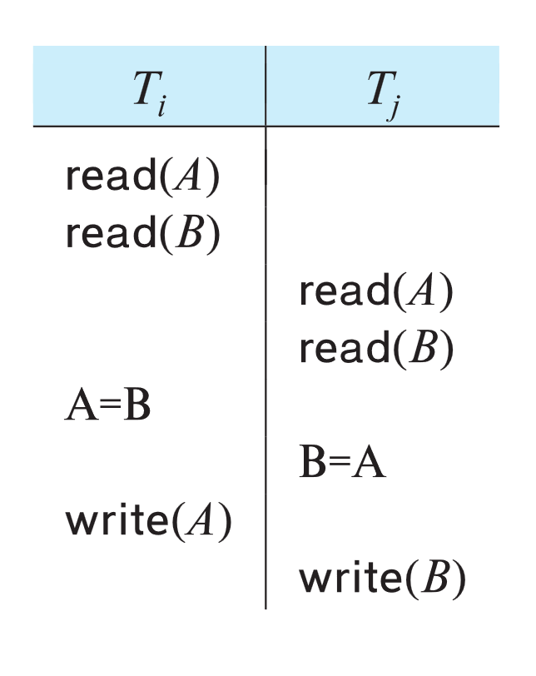
Snapshot Isolation
Example of problem with SI
Initially A = 3 and B = 17
Serial execution: A = ??, B = ??
if both transactions start at the same time, with snapshot isolation: A = ?? , B = ??
Called skew write
Skew also occurs with inserts
E.g:
Find max order number among all orders
Create a new order with order number = previous max + 1
Two transaction can both create order with same number
Is an example of phantom phenomenon
Notes:
تمرین.

Slide 84
Snapshot Isolation Anomalies
SI breaks serializability when transactions modify different items, each based on a previous state of the item the other modified
Not very common in practice
E.g., the TPC-C benchmark runs correctly under SI
when txns conflict due to modifying different data, there is usually also a shared item they both modify, so SI will abort one of them
But problems do occur
Application developers should be careful about write skew
SI can also cause a read-only transaction anomaly, where read-only transaction may see an inconsistent state even if updaters are serializable
We omit details
Using snapshots to verify primary/foreign key integrity can lead to inconsistency
Integrity constraint checking usually done outside of snapshot

Slide 85
Serializable Snapshot Isolation
Serializable snapshot isolation (SSI): extension of snapshot isolation that ensures serializability
Snapshot isolation tracks write-write conflicts, but does not track read-write conflicts
Where T_{i} writes a data a data item Q, T_{j} reads an earlier version of Q, but T_{j} is serialized after T_{i}
Idea: track read-write dependencies separately, and roll-back transactions where cycles can occur
Ensures serializability
Details in book
Implemented in PostgreSQL from version 9.1 onwards
PostgreSQL implementation of SSI also uses index locking to detect phantom conflicts, thus ensuring true serializability

Slide 86
SI Implementations
Snapshot isolation supported by many databases
Including Oracle, PostgreSQL, SQL Server, IBM DB2, etc
Isolation level can be set to snapshot isolation
Oracle implements “first updater wins” rule (variant of “first committer wins”)
Concurrent writer check is done at time of write, not at commit time
Allows transactions to be rolled back earlier
Warning: even if isolation level is set to serializable, Oracle actually uses snapshot isolation
Old versions of PostgreSQL prior to 9.1 did this too
Oracle and PostgreSQL < 9.1 do not support true serializable execution

Slide 87
Working Around SI Anomalies
Can work around SI anomalies for specific queries by using select .. for update (supported e.g. in Oracle)
Example
select max(orderno) from orders for update
read value into local variable maxorder
insert into orders (maxorder+1, …)
select for update (SFU) clause treats all data read by the query as if it were also updated, preventing concurrent updates
Can be added to queries to ensure serializability in many applications
Does not handle phantom phenomenon/predicate reads though
Notes:
87

Slide 88
Weak Levels of Concurrency

Slide 89
Weak Levels of Consistency
Degree-two consistency: differs from two-phase locking in that S-locks may be released at any time, and locks may be acquired at any time
X-locks must be held till end of transaction
Serializability is not guaranteed, programmer must ensure that no erroneous database state will occur]
Cursor stability:
For reads, each tuple is locked, read, and lock is immediately released
X-locks are held till end of transaction
Special case of degree-two consistency

Slide 90
Weak Levels of Consistency in SQL
SQL allows non-serializable executions
Serializable: is the default
Repeatable read: allows only committed records to be read, and repeating a read should return the same value (so read locks should be retained)
However, the phantom phenomenon need not be prevented
T1 may see some records inserted by T2, but may not see others inserted by T2
Read committed: same as degree two consistency, but most systems implement it as cursor-stability
Read uncommitted: allows even uncommitted data to be read
In most database systems, read committed is the default consistency level
Can be changed as database configuration parameter, or per transaction
set isolation level serializable

Slide 91
Concurrency Control across User Interactions
Many applications need transaction support across user interactions
Can’t use locking for long durations
Application level concurrency control
Each tuple has a version number
Transaction notes version number when reading tuple
select r.balance, r.version into :A, :version from r where acctId =23
When writing tuple, check that current version number is same as the version when tuple was read
update r set r.balance = r.balance + :deposit, r.version = r.version+1 where acctId = 23 and r.version = :version

Slide 92
Concurrency Control across User Interactions
Equivalent to optimistic concurrency control without validating read set
Unlike SI, reads are not guaranteed to be from a single snapshot.
Does not guarantee serializability
But avoids some anomalies such as “lost update anomaly”
Used internally in Hibernate ORM system
Implemented manually in many applications
Version numbers stored in tuples can also be used to support first committer wins check of snapshot isolation

Slide 93
Advanced topics in Concurrency Control

Slide 94
Online Index Creation
Problem: how to create an index on a large relation without affecting concurrent updates
Index construction may take a long time
Two-phase locking will block all concurrent updates
Key ideas:
Build index on a snapshot of the relation, but keep track of all updates that occur after snapshot
Updates are not applied on the index at this point
Then apply subsequent updates to catch up
Acquire relation lock towards end of catchup phase to block concurrent updates
Catch up with remaining updates, and add index to system catalog
Subsequent transactions will find the index in catalog and update it

Slide 95
Concurrency in Index Structures
Indices are unlike other database items in that their only job is to help in accessing data.
Index-structures are typically accessed very often, much more than other database items.
Treating index-structures like other database items, e.g. by 2-phase locking of index nodes can lead to low concurrency.
There are several index concurrency protocols where locks on internal nodes are released early, and not in a two-phase fashion.
It is acceptable to have nonserializable concurrent access to an index as long as the accuracy of the index is maintained.
In particular, the exact values read in an internal node of a B⁺-tree are irrelevant so long as we land up in the correct leaf node.

Slide 96
Concurrency in Index Structures (Cont.)
Crabbing protocol used instead of two-phase locking on the nodes of the B⁺-tree during search/insertion/deletion:
First lock the root node in shared mode.
After locking all required children of a node in shared mode, release the lock on the node
During insertion/deletion, upgrade leaf node locks to exclusive mode.
When splitting or coalescing requires changes to a parent, lock the parent in exclusive mode.
Above protocol can cause excessive deadlocks
Searches coming down the tree deadlock with updates going up the tree
Can abort and restart search, without affecting transaction
The B-link tree locking protocol improves concurrency
Intuition: release lock on parent before acquiring lock on child
And deal with changes that may have happened between lock release and acquire

Slide 97
Concurrency Control in Main-Memory Databases
Index locking protocols can be simplified with main-memory databases
Short term lock can be obtained on entire index for duration of an operation, serializing updates on the index
Avoids overheads of multiple lock acquire/release
No major penalty since operations finish fast, since there is no disk wait
Latch-free techniques for data-structure update can speed up operations further

Slide 98
Latch-Free Data-structure Updates
This code is not safe without latches if executed concurrently:
insert(value, head) { node = new node node−>value = value node−>next = head head = node }
This code is safe insert latchfree(head, value) { node = new node node−>value = value repeat oldhead = head node−>next = oldhead result = CAS(head, oldhead, node) until (result == success) }

Slide 99
Latch-Free Data-structure Updates
This code is not safe without latches if executed concurrently:
insert(value, head) { node = new node node−>value = value node−>next = head head = node }
This code is safe insert latchfree(head, value) { node = new node node−>value = value repeat oldhead = head node−>next = oldhead result = CAS(head, oldhead, node) until (result == success) }

Slide 100
Latch-Free Data-structures (Cont.)
Consider:
delete latchfree(head) { /* This function is not quite safe; see explanation in text. */ repeat oldhead = head newhead = oldhead−>next result = CAS(head, oldhead, newhead) until (result == success) }
Above code is almost correct, but has a concurrency bug
P1 initiates delete with N1 as head; concurrently P2 deletes N1 and next node N2, and then reinserts N1 as head, with N3 as next
P1 may set head as N2 instead of N3.
Known as ABA problem
See book for details of how to avoid this problem

Slide 101
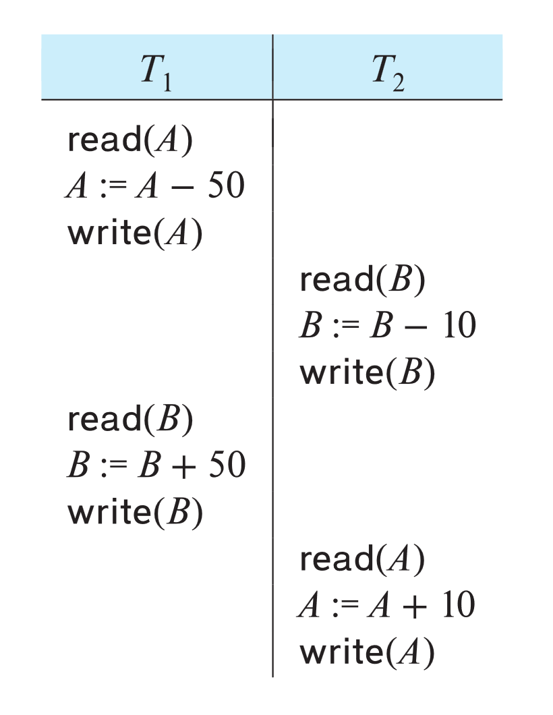
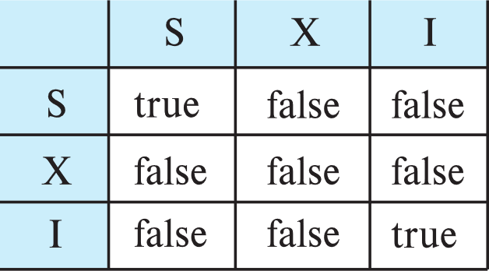
Concurrency Control with Operations
Consider this non-two phase schedule, which preserves database integrity constraints
Can be understood as transaction performing increment operation
E.g., increment(A, -50), increment (B, 50)
As long as increment operation does not return actual value, increments can be reordered
Increments commute
New increment-mode lock to support reordering
Conflict matrix with increment lock mode
Two increment operations do not conflict with each other

Slide 102
Concurrency Control with Operations (Cont.)
Undo of increment(v, n) is performed by increment (v, -n)
Increment_conditional(v, n):
Updates v by adding n to it, as long as final v > 0, fails otherwise
Can be used to model, e.g. number of available tickets, avail_tickets, for a concert
Increment_conditional is NOT commutative
E.g., last few tickets for a concert
But reordering may still be acceptable

Slide 103
Real-Time Transaction Systems
Transactions in a system may have deadlines within which they must be completed.
Hard deadline: missing deadline is an error
Firm deadline: value of transaction is 0 in case deadline is missed
Soft deadline: transaction still has some value if done after deadline
Locking can cause blocking
Optimistic concurrency control (validation protocol) has been shown to do will in a real-time setting

Slide 104
End of Chapter 18

Slide 105
Insert/Delete Operations and Predicate Reads
Locking rules for insert/delete operations
An exclusive lock must be obtained on an item before it is deleted
A transaction that inserts a new tuple into the database I automatically given an X-mode lock on the tuple
Ensures that
reads/writes conflict with deletes
Inserted tuple is not accessible by other transactions until the transaction that inserts the tuple commits

Slide 106
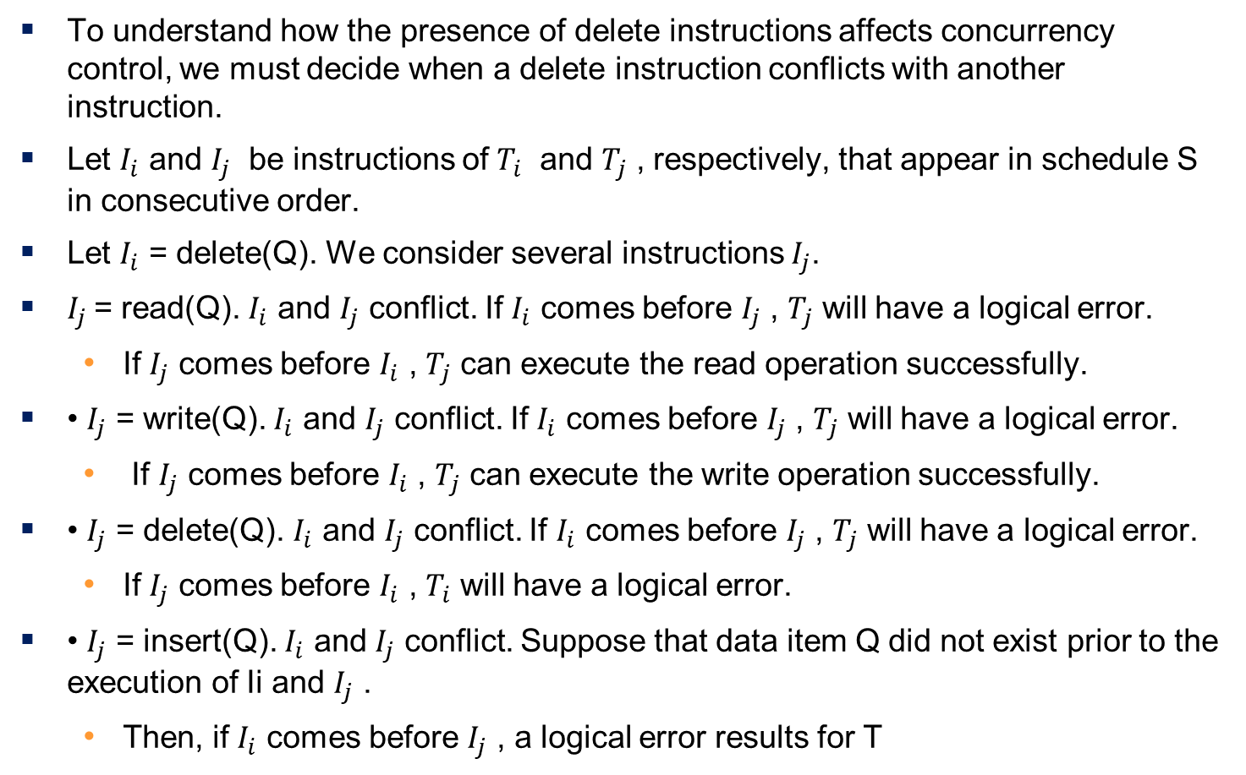
Delete Operations,
To understand how the presence of delete instructions affects concurrency control, we must decide when a delete instruction conflicts with another instruction.
Let $I_{i}$ and $I_{j}$ be instructions of $T_{i}$ and $T_{j}$ , respectively, that appear in schedule S in consecutive order.
Let $I_{i}$ = delete(Q). We consider several instructions $I_{j}$.
$I_{j}$= read(Q). $I_{i}$ and $I_{j}$ conflict. If $I_{i}$ comes before $I_{j}$ , $T_{j}$ will have a logical error.
If $I_{j}$ comes before $I_{i}$ , $T_{j}$ can execute the read operation successfully.
• $I_{j}$ = write(Q). $I_{i}$ and $I_{j}$ conflict. If $I_{i}$ comes before $I_{j}$ , $T_{j}$ will have a logical error.
If $I_{j}$ comes before $I_{i}$ , $T_{j}$ can execute the write operation successfully.
• $I_{j}$ = delete(Q). $I_{i}$ and $I_{j}$ conflict. If $I_{i}$ comes before $I_{j}$ , $T_{j}$ will have a logical error.
If $I_{j}$ comes before $I_{i}$ , $T_{i}$ will have a logical error.
• $I_{j}$ = insert(Q). $I_{i}$ and $I_{j}$ conflict. Suppose that data item Q did not exist prior to the execution of Ii and $I_{j}$ .
Then, if $I_{i}$ comes before $I_{j}$ , a logical error results for T

Slide 107
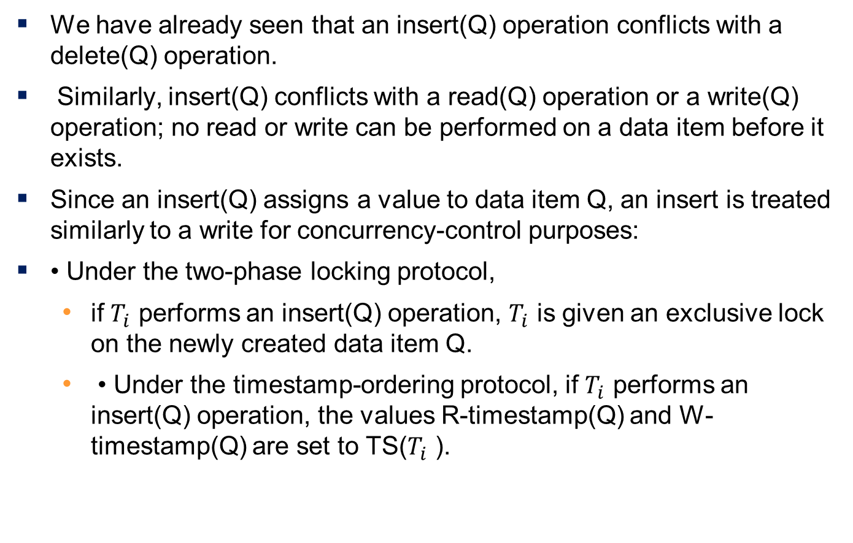
Insertion
We have already seen that an insert(Q) operation conflicts with a delete(Q) operation.
Similarly, insert(Q) conflicts with a read(Q) operation or a write(Q) operation; no read or write can be performed on a data item before it exists.
Since an insert(Q) assigns a value to data item Q, an insert is treated similarly to a write for concurrency-control purposes:
• Under the two-phase locking protocol,
if $T_{i}$ performs an insert(Q) operation, $T_{i}$ is given an exclusive lock on the newly created data item Q.
• Under the timestamp-ordering protocol, if $T_{i}$ performs an insert(Q) operation, the values R-timestamp(Q) and W-timestamp(Q) are set to TS($T_{i}$ ).

Slide 108
Phantom Phenomenon
Example of phantom phenomenon.
A transaction T30 that performs predicate read (or scan) of a relation
select count(*) from instructor where dept_name = 'Physics'
and a transaction T31 that inserts a tuple while T0 is active but after predicate read
insert into instructor values ('11111', 'Feynman', 'Physics', 94000)
(conceptually) conflict in spite of not accessing any tuple in common.
If only tuple locks are used, non-serializable schedules can result
E.g. the scan transaction does not see the new instructor, but may read some other tuple written by the update transaction
Can also occur with updates
E.g. update Wu’s department from Finance to Physics
Notes:
فرض کنید تراکنش T30 یک خواندن پیش‌شرط (یا اسکن) از رابطه‌ی اساتید انجام می‌دهد:
در همین حال، تراکنش T31 یک رکورد جدید اضافه می‌کند در حالی که T30 فعال است، اما بعد از خواندن پیش‌شرط:
• از لحاظ مفهومی، درگیری رخ می‌دهد، با اینکه هیچ رکورد مشترکی بین آن‌ها دسترسی داده نشده است.
• اگر فقط از قفل‌های روی تک تک رکوردها استفاده شود، می‌توانند جدول‌بندی‌های غیرقابل سریال‌سازی ایجاد کنند.
به عنوان مثال، تراکنش اسکن، استاد جدید را نمی‌بیند، اما ممکن است رکورد دیگری را بخواند که توسط تراکنش درج، نوشته شده است.
• این پدیده همچنین می‌تواند با به‌روزرسانی رخ دهد.
به عنوان مثال، به‌روزرسانی کردن دپارتمان Wu از مالی به فیزیک
Let S be a schedule involving T30 and T31. We expect there to be potential for a conflict for the following reasons:
• If T30 uses the tuple newly inserted by T31 in computing count(*), then T30 reads a value written by T31.
Thus, in a serial schedule equivalent to S, T31 must come before T30.
• If T30 does not use the tuple newly inserted by T31 in computing count(*), then in a serial schedule equivalent to S, T30 must come before T31.

Slide 109
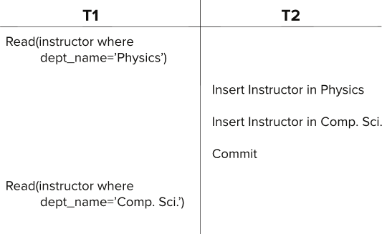
Insert/Delete Operations and Predicate Reads
Another Example: T1 and T2 both find maximum instructor ID in parallel, and create new instructors with ID = maximum ID + 1
Both instructors get same ID, not possible in serializable schedule
Schedule
Notes:
نمونه‌ی دیگر: فرض کنید تراکنش T1 و T2 به طور موازی، بیشترین شناسه (ID) استاد را پیدا می‌کنند و استادان جدیدی با شناسه‌ی برابر با بیشترین شناسه‌ی یافت شده به علاوه‌ی ۱ ایجاد می‌کنند.
در این سناریو، هر دو استاد شناسه‌ی یکسانی دریافت می‌کنند که در یک جدول‌بندی قابل سریال‌سازی (سریالی) امکان‌پذیر نیست.
جدول‌بندی

Slide 110
Handling Phantoms
There is a conflict at the data level
The transaction performing predicate read or scanning the relation is reading information that indicates what tuples the relation contains
The transaction inserting/deleting/updating a tuple updates the same information.
The conflict should be detected, e.g. by locking the information.
One solution:
Associate a data item with the relation, to represent the information about what tuples the relation contains.
Transactions scanning the relation acquire a shared lock in the data item,
Transactions inserting or deleting a tuple acquire an exclusive lock on the data item. (Note: locks on the data item do not conflict with locks on individual tuples.)
Above protocol provides very low concurrency for insertions/deletions.
Notes:
در سطح داده درگیری (تناقض) وجود دارد:
تراکنشی که عمل خواندن پیش‌شرط (predicate read) یا اسکن کردن رابطه (relation) را انجام می‌دهد، اطلاعاتی را می‌خواند که نشان می‌دهد رابطه چه کوپل‌هایی (tuples) را در خود جای داده است.
تراکنشی که یک کوپل را درج / حذف / به روز رسانی می‌کند، همین اطلاعات را به روز رسانی می‌کند.
این درگیری باید شناسایی شود، به عنوان مثال با قفل کردن اطلاعات.
یک راه‌حل:
یک آیتم داده را با رابطه مرتبط کنید تا اطلاعات مربوط به کوپل‌هایی که رابطه حاوی آن‌ها است را نشان دهد.
تراکنش‌هایی که رابطه را اسکن می‌کنند، یک قفل اشتراکی روی آیتم داده کسب می‌کنند.
تراکنش‌هایی که یک کوپل را درج یا حذف می‌کنند، یک قفل انحصاری روی آیتم داده کسب می‌کنند. (توجه: قفل‌های روی آیتم داده با قفل‌های روی تک تک کوپل‌ها تداخل ندارند.)
پروتکل فوق برای درج‌ها / حذف‌ها، همزمانی (concurrency) بسیار پایینی را ارائه می‌دهد.

Slide 111
Index Locking To Prevent Phantoms
Index locking protocol to prevent phantoms
Every relation must have at least one index.
A transaction can access tuples only after finding them through one or more indices on the relation
A transaction T_{i} that performs a lookup must lock all the index leaf nodes that it accesses, in S-mode
Even if the leaf node does not contain any tuple satisfying the index lookup (e.g. for a range query, no tuple in a leaf is in the range)
A transaction T_{i} that inserts, updates or deletes a tuple t_{i} in a relation r
Must update all indices to r
Must obtain exclusive locks on all index leaf nodes affected by the insert/update/delete
The rules of the two-phase locking protocol must be observed
Guarantees that phantom phenomenon won’t occur

Slide 112
Next-Key Locking to Prevent Phantoms
Index-locking protocol to prevent phantoms locks entire leaf node
Can result in poor concurrency if there are many inserts
Next-key locking protocol: provides higher concurrency
Lock all values that satisfy index lookup (match lookup value, or fall in lookup range)
Also lock next key value in index
even for inserts/deletes
Lock mode: S for lookups, X for insert/delete/update
Ensures detection of query conflicts with inserts, deletes and updates
Consider B+-tree leaf nodes as below, with query predicate 7 $≤$ X $≤$ 16. Check what happens with next-key locking when inserting: (i) 15 and (ii) 7

